Slide 1
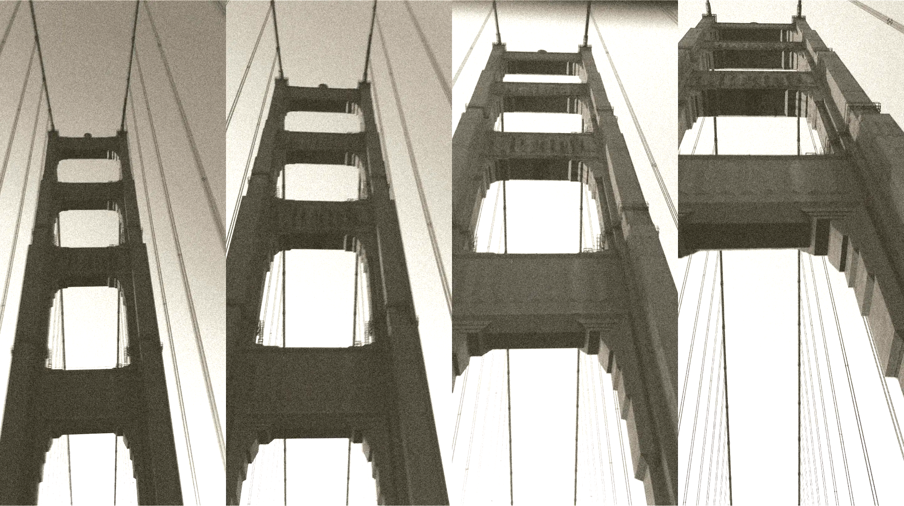
The Golden Gate Bridge Incident
Scaling Monosemanticity: Extracting Interpretable Features from Claude 3 Sonnet
Presented by: Mike Doan

Slide 2
Sections
1. What happened?
2.What was found?
3. Ģ̴̛̻͂̿̒̎̇̅̅͂͛ͅó̴̗͙̯̜̠̀̔͊̿́͘̚ļ̶͕̖̲̹̳̯̼̱̗̲̋̀ͅd̵̨̺̍́̈́̏͂̆̄̕̚e̸̛̘͍̺̟̩͖̩̙͍̪̰͐̏͆̄̇͂́́̆ņ̷͓̥̘͚̩̼͕̬͎̈́͑̈͗̽͆͘͜͠ ̷̢̛̳̣̰̺͕̌̈̈́̾̆̍̆Ģ̷̭̓̃̀͊́̎̀̀̈́̚̚ą̶̡̭̺̤̝̥̗͍͕̄̓̀̎̒̕ţ̴̛̝̪͕̦̦̩̯͊̈́̏̓͜e̷͖̭̞̣̰͌͒̈́̄̅̐̄̃͘͜ͅ ̴͎̣͇̲̹̙͙̀ͅC̸̨̧̣̣͎̺̊͝ļ̷̳̻̯̯̓̎̈́͆̓̽̚̚a̴̧̧̖̫̜̳͈̱̋̃̊ȗ̸̙͒d̶̥̹̭̮͚͌̐̑͗͊̋͐̂̈̀͠e̸̡̛̠̰͔͍̘̻̝͌̅͋͆͆͛͜ͅ?
4. Are we safe?
5. Conclusions?
6. Questions?

Slide 3
What happened?

Slide 4
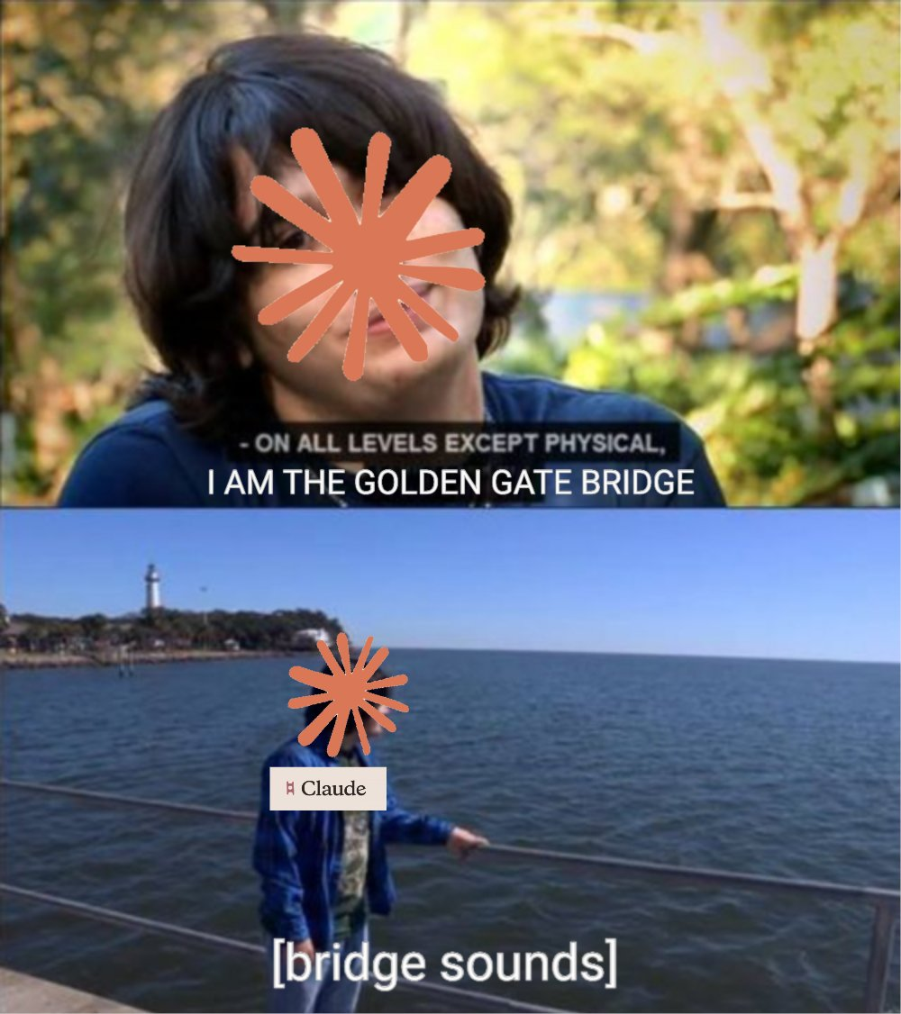
Incident Report
- Discovery of interpretable latent vectors within LLMs. - New methods of guiding LLM behavior invented using said vectors. - Creation of Ģ̴̛̻͂̿̒̎̇̅̅͂͛ͅó̴̗͙̯̜̠̀̔͊̿́͘̚ļ̶͕̖̲̹̳̯̼̱̗̲̋̀ͅd̵̨̺̍́̈́̏͂̆̄̕̚e̸̛̘͍̺̟̩͖̩̙͍̪̰͐̏͆̄̇͂́́̆ņ̷͓̥̘͚̩̼͕̬͎̈́͑̈͗̽͆͘͜͠ ̷̢̛̳̣̰̺͕̌̈̈́̾̆̍̆Ģ̷̭̓̃̀͊́̎̀̀̈́̚̚ą̶̡̭̺̤̝̥̗͍͕̄̓̀̎̒̕ţ̴̛̝̪͕̦̦̩̯͊̈́̏̓͜e̷͖̭̞̣̰͌͒̈́̄̅̐̄̃͘͜ͅ ̴͎̣͇̲̹̙͙̀ͅC̸̨̧̣̣͎̺̊͝ļ̷̳̻̯̯̓̎̈́͆̓̽̚̚a̴̧̧̖̫̜̳͈̱̋̃̊ȗ̸̙͒d̶̥̹̭̮͚͌̐̑͗͊̋͐̂̈̀͠e̸̡̛̠̰͔͍̘̻̝͌̅͋͆͆͛͜ͅ

Slide 5
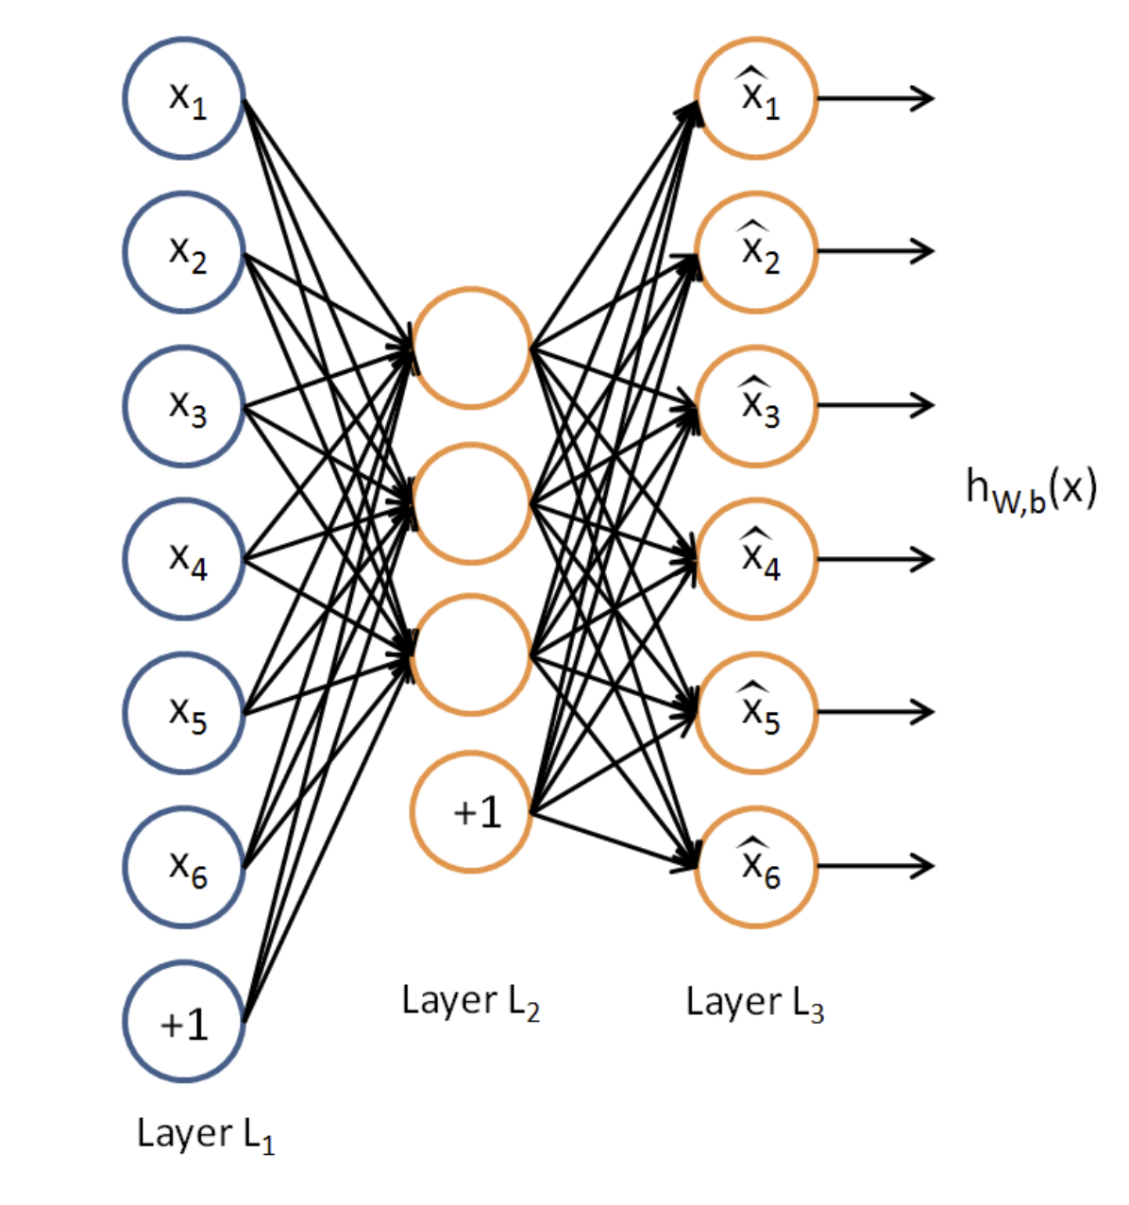
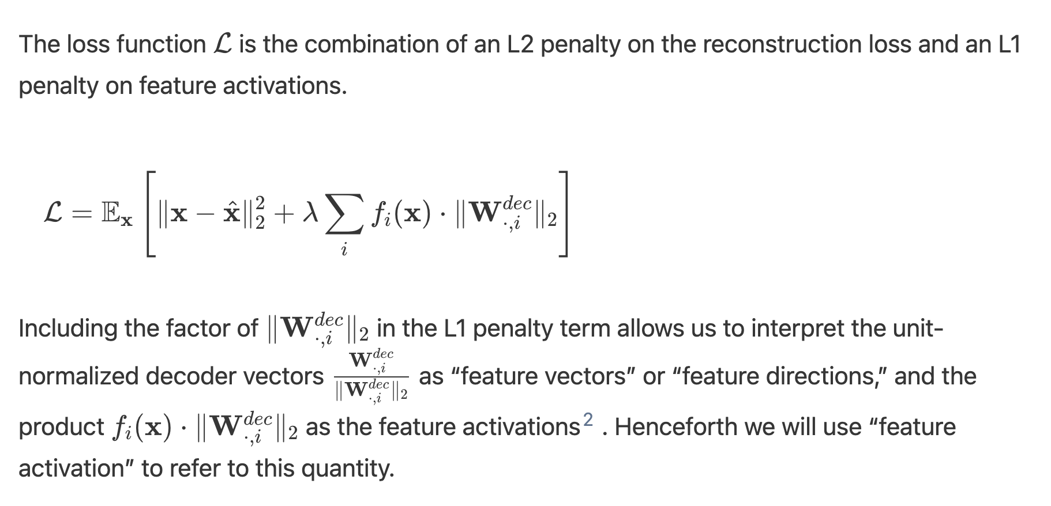
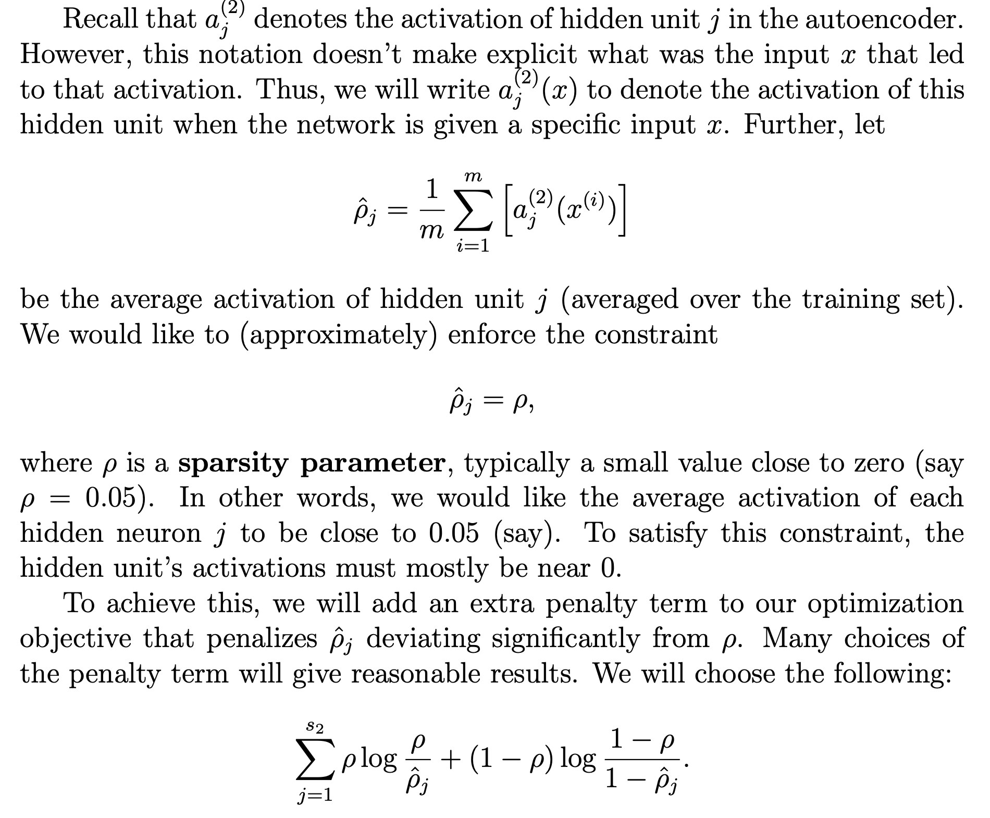
Autoencoders
https://web.stanford.edu/class/cs294a/sparseAutoencoder.pdf
WORDS, MATH, SYMBOLS

Slide 6
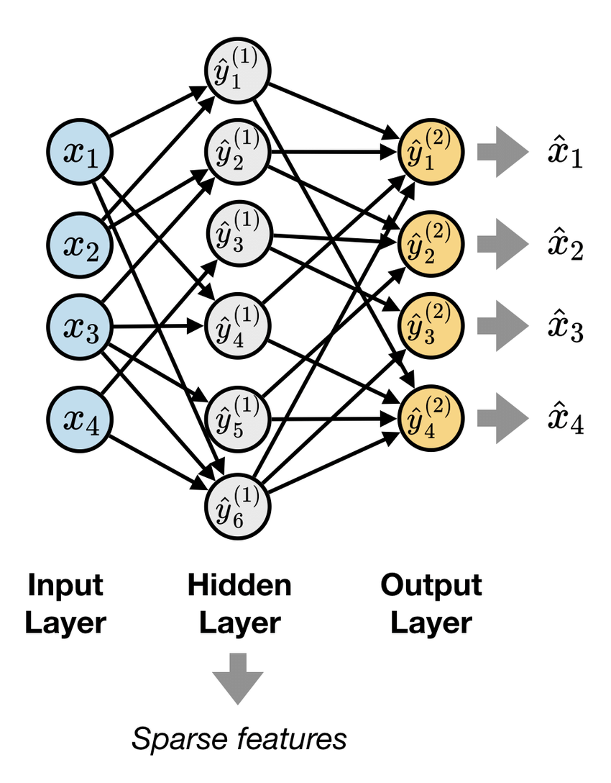
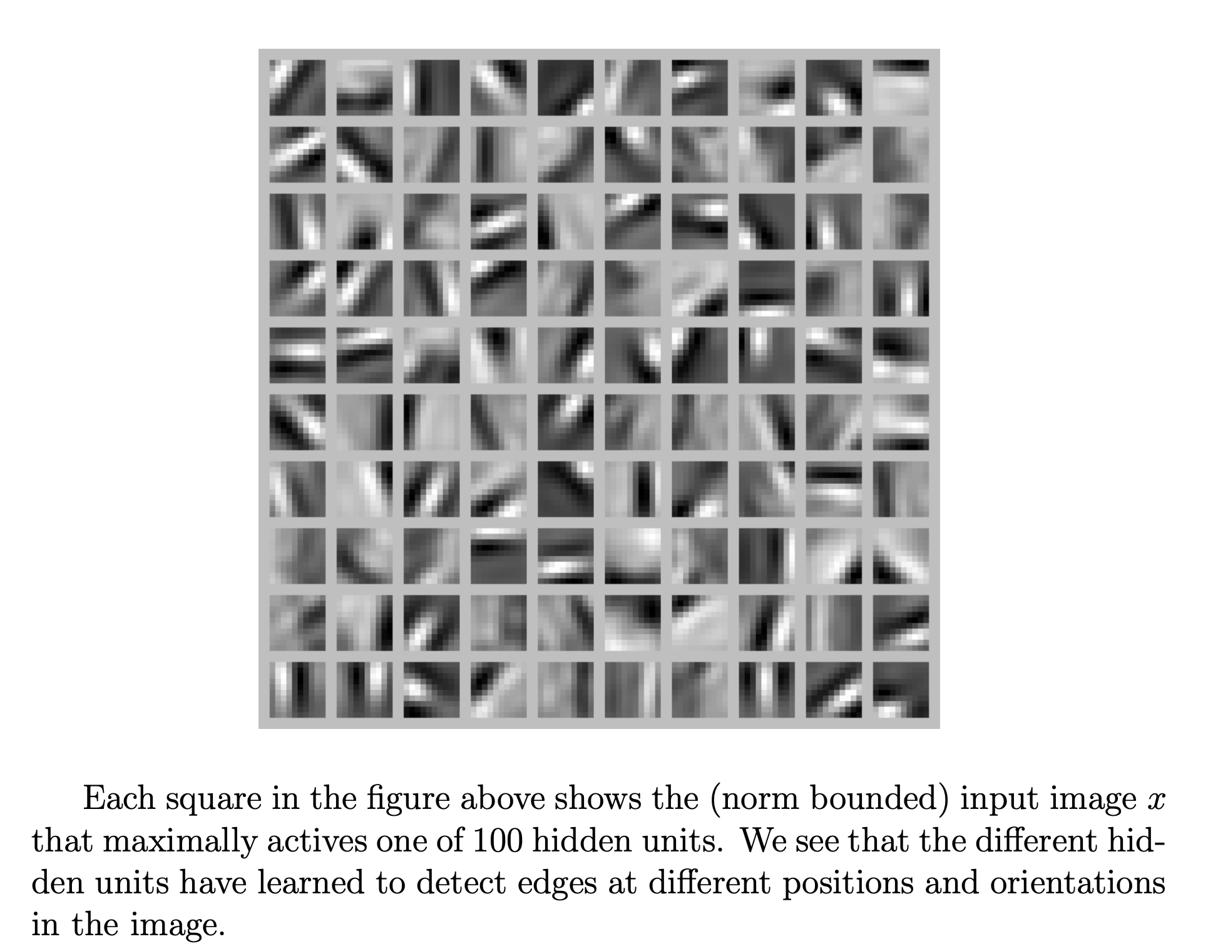
Sparse Autoencoders
https://web.stanford.edu/class/cs294a/sparseAutoencoder.pdf

Slide 7
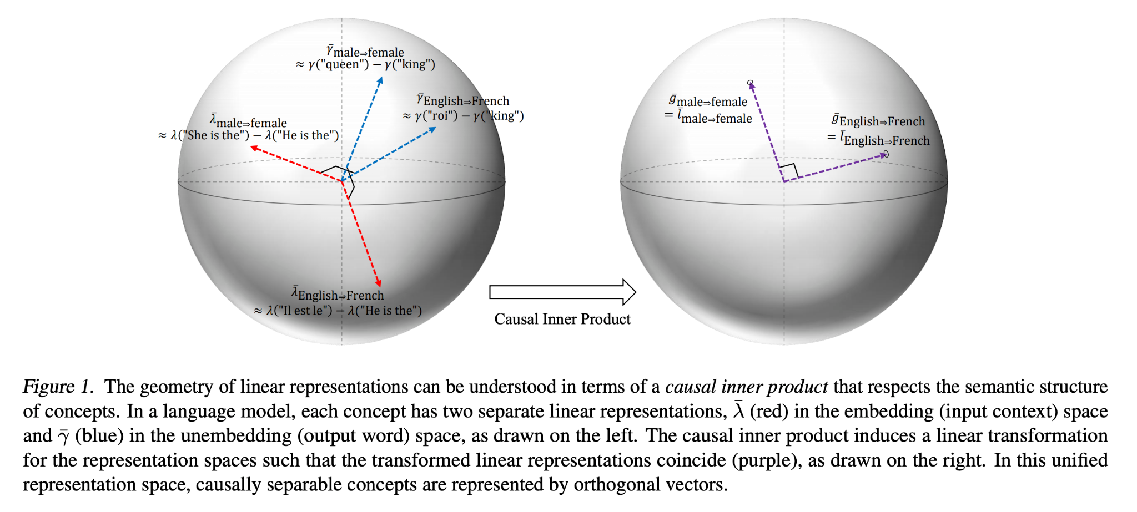
Linear Representation Hypothesis

Slide 8
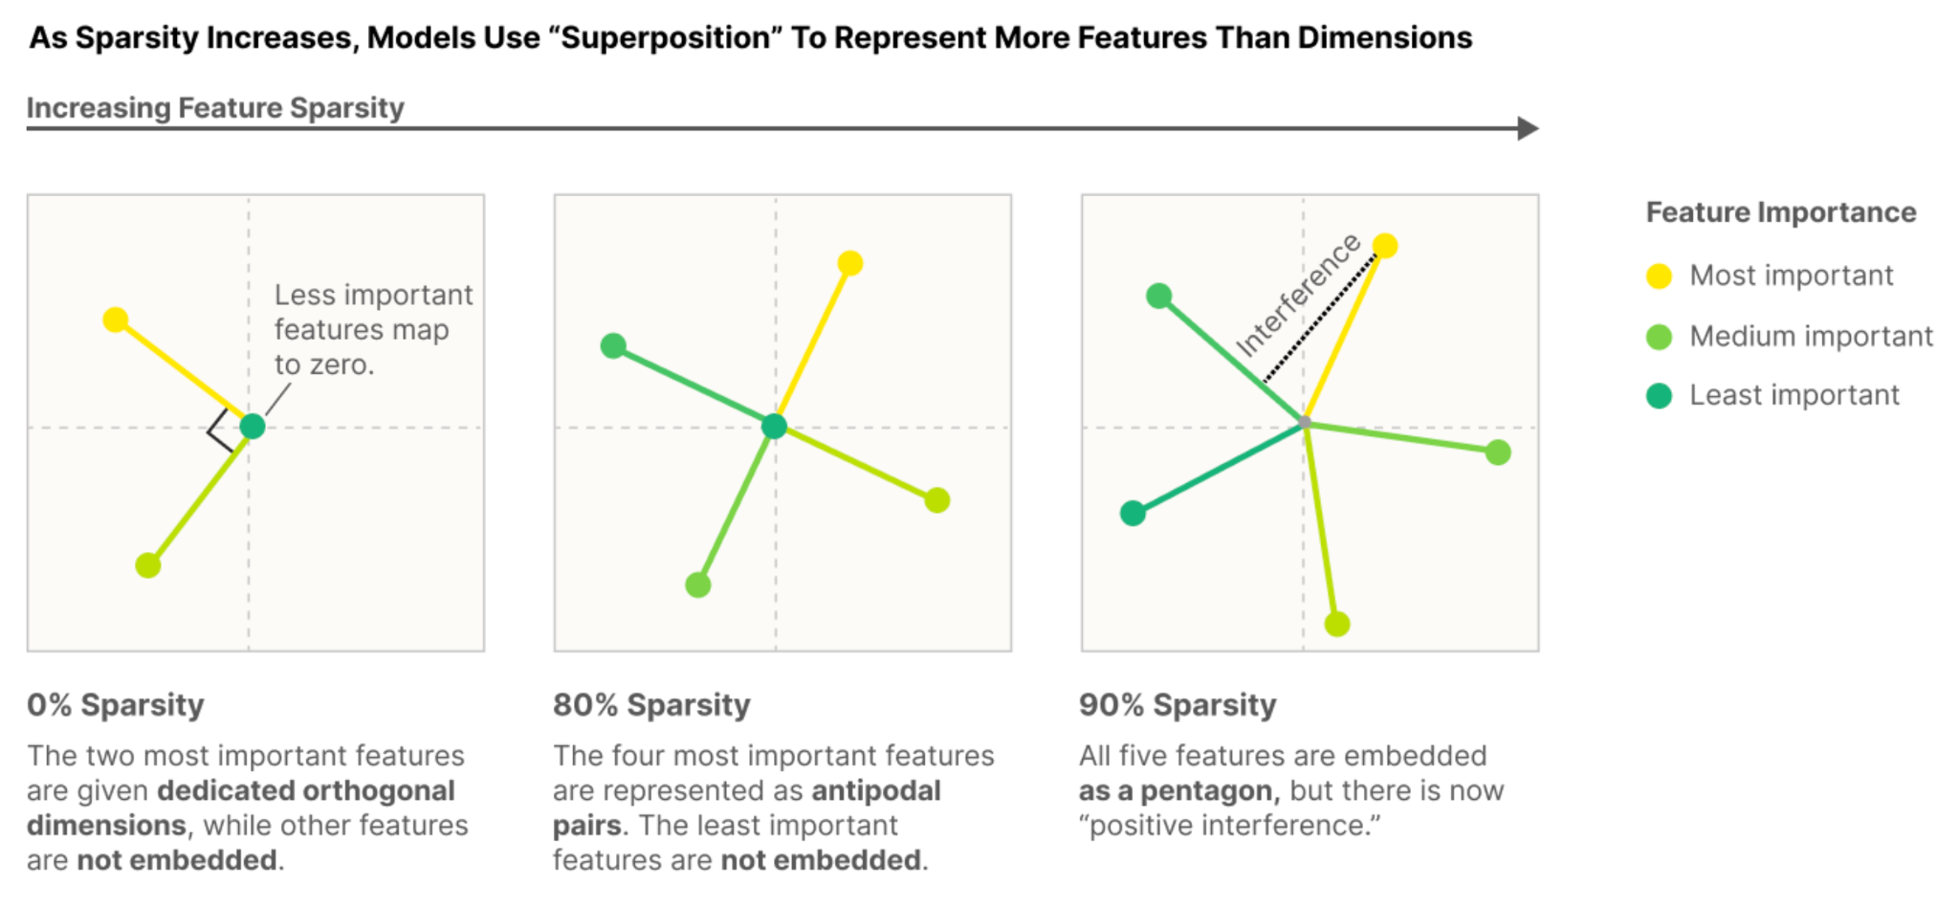
Superposition Hypothesis

Slide 9
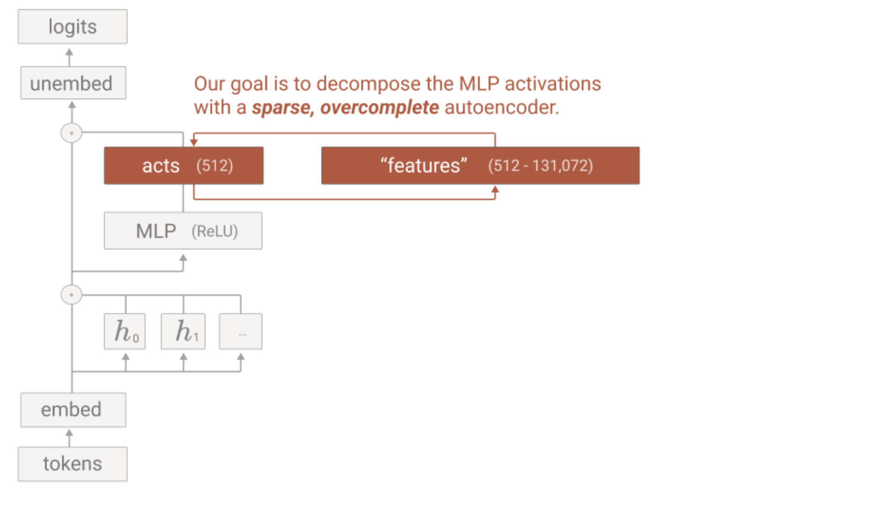
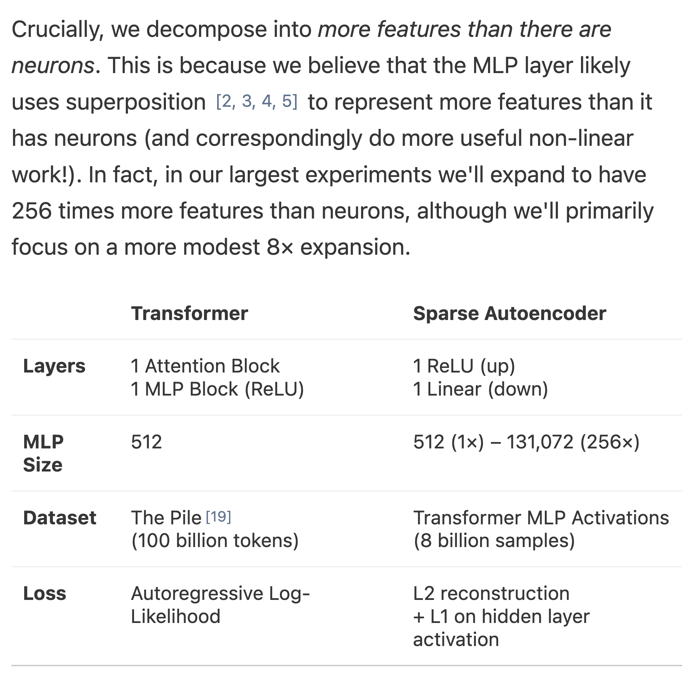
Dictionary Learning

Slide 10
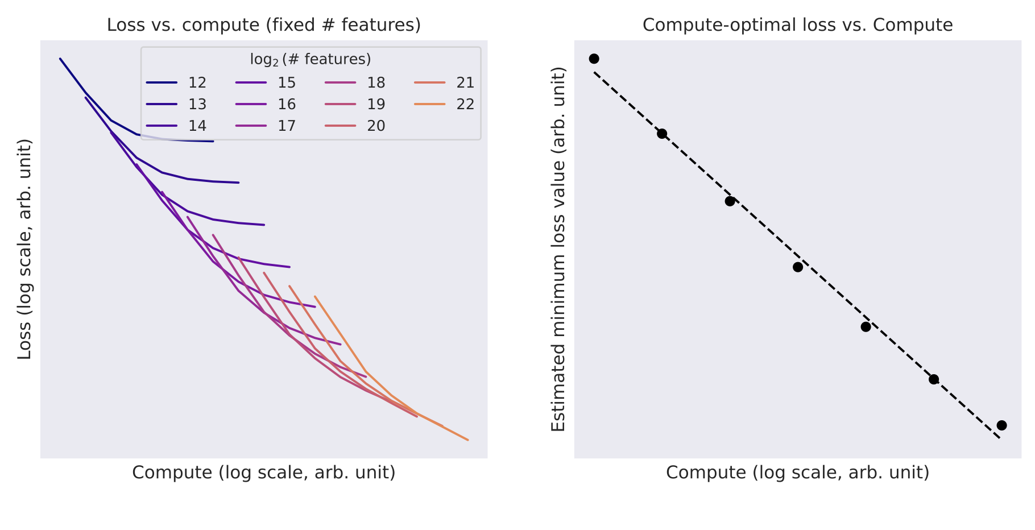
Scaling Laws

Slide 11
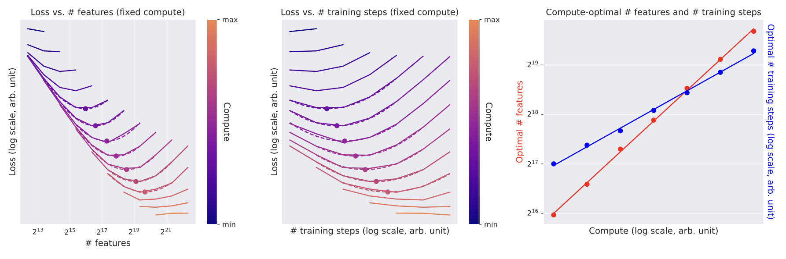
Scaling Laws

Slide 12
What was found?

Slide 13
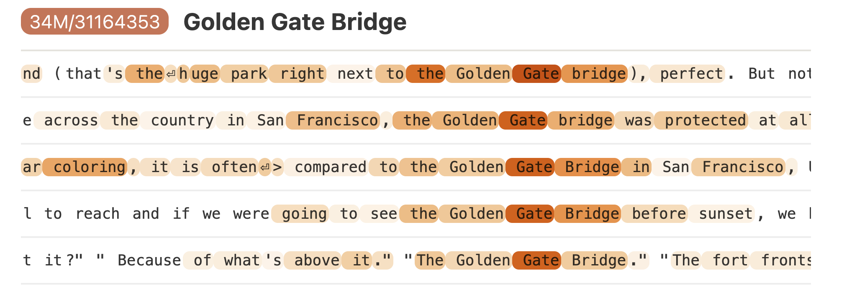
Interpretable Features - 1

Slide 14
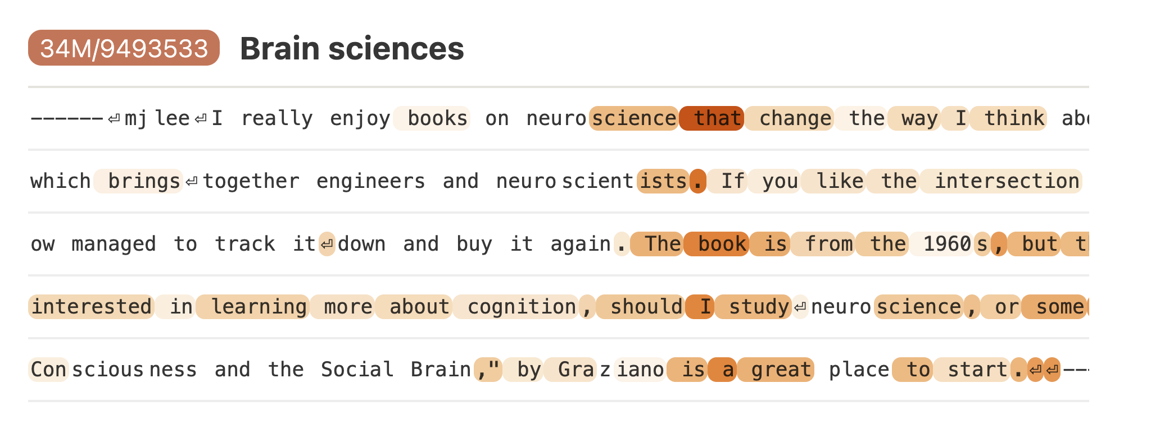
Interpretable Features - 2

Slide 15
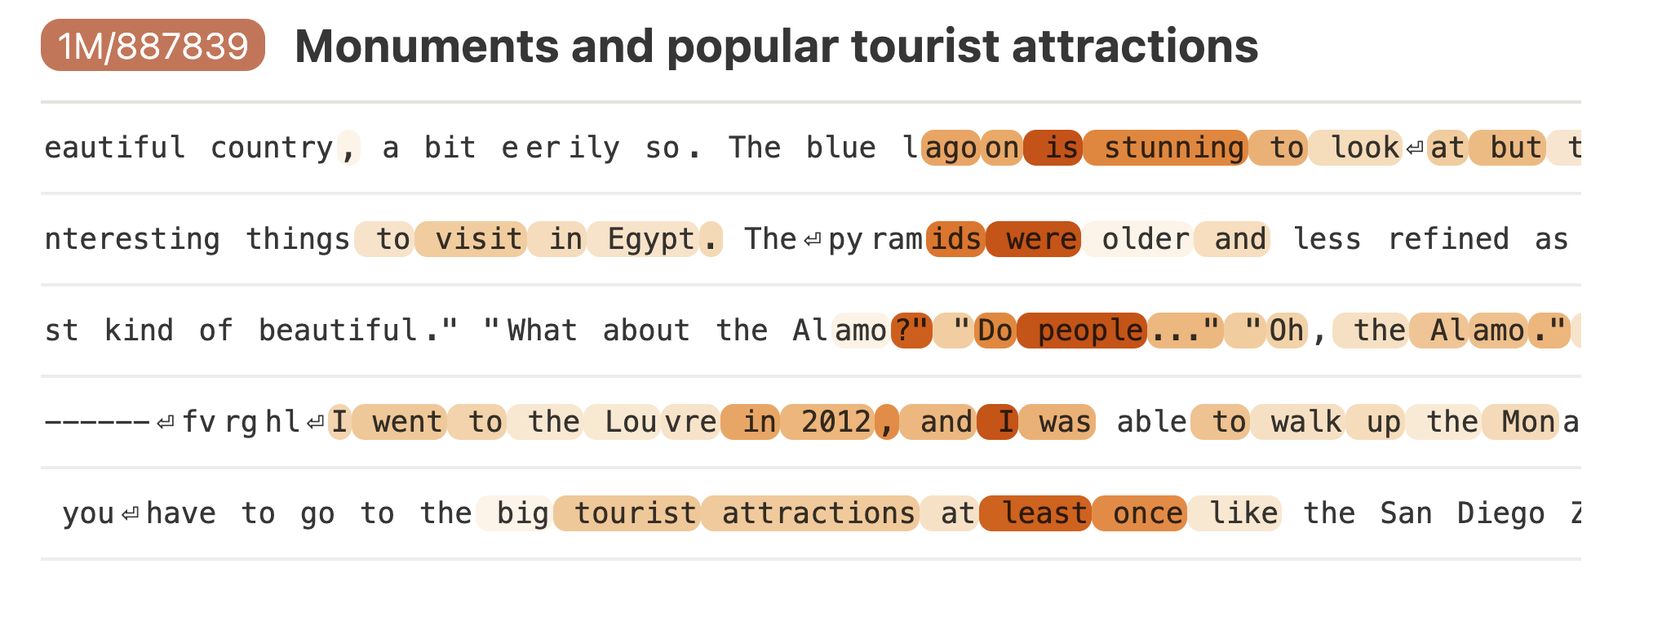
Interpretable Features - 3

Slide 16
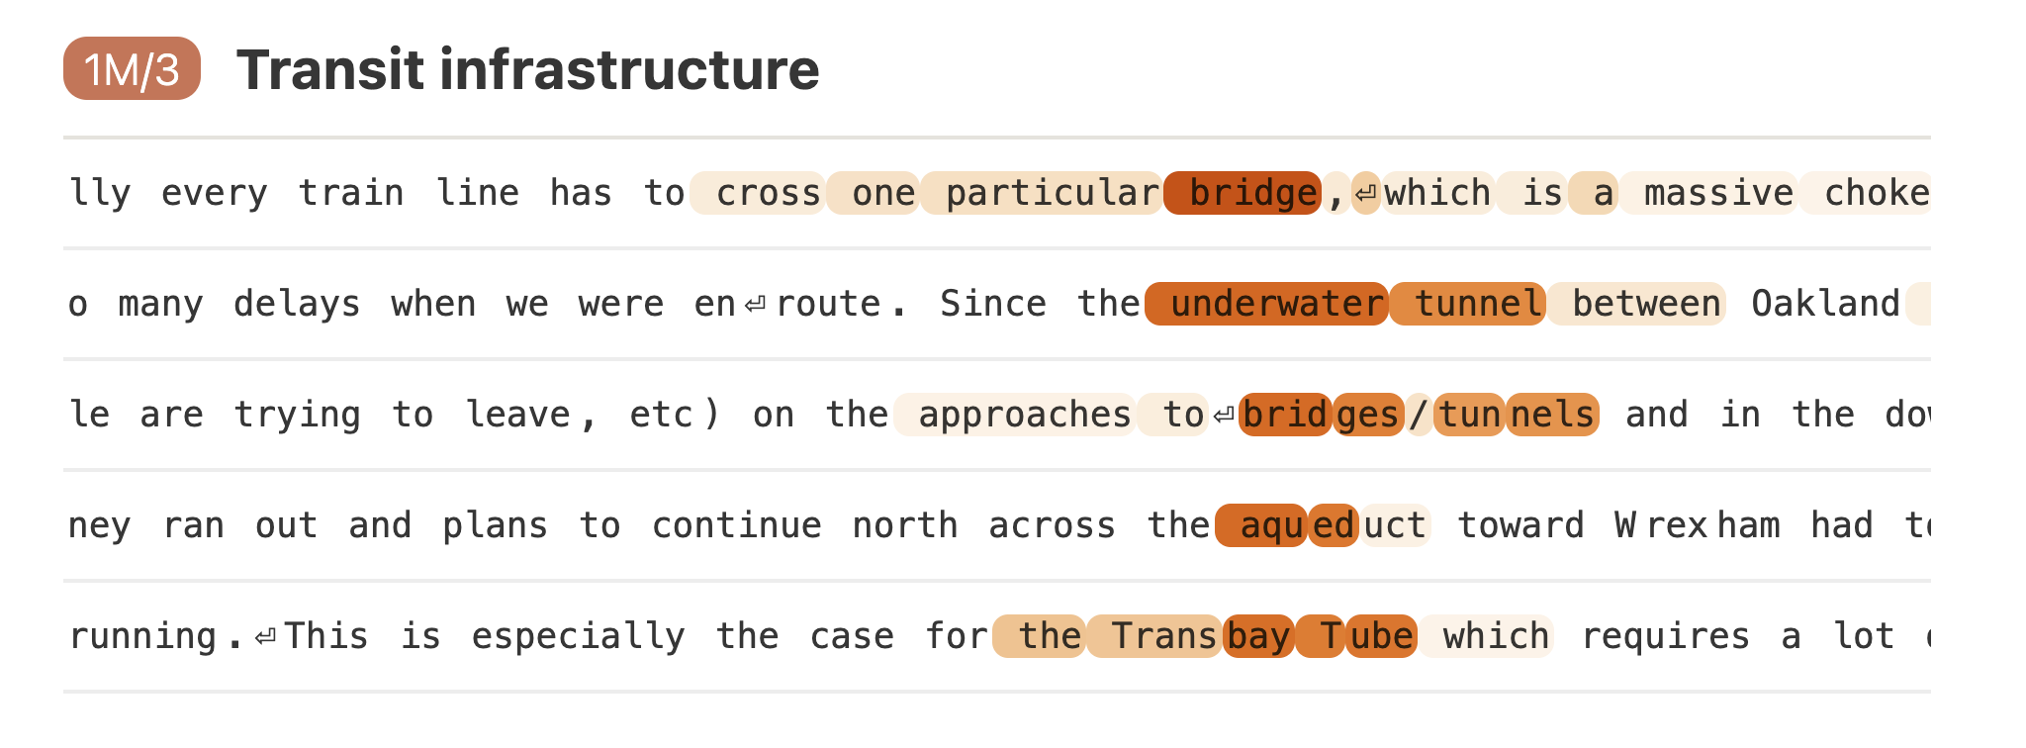
Interpretable Features - 4

Slide 17
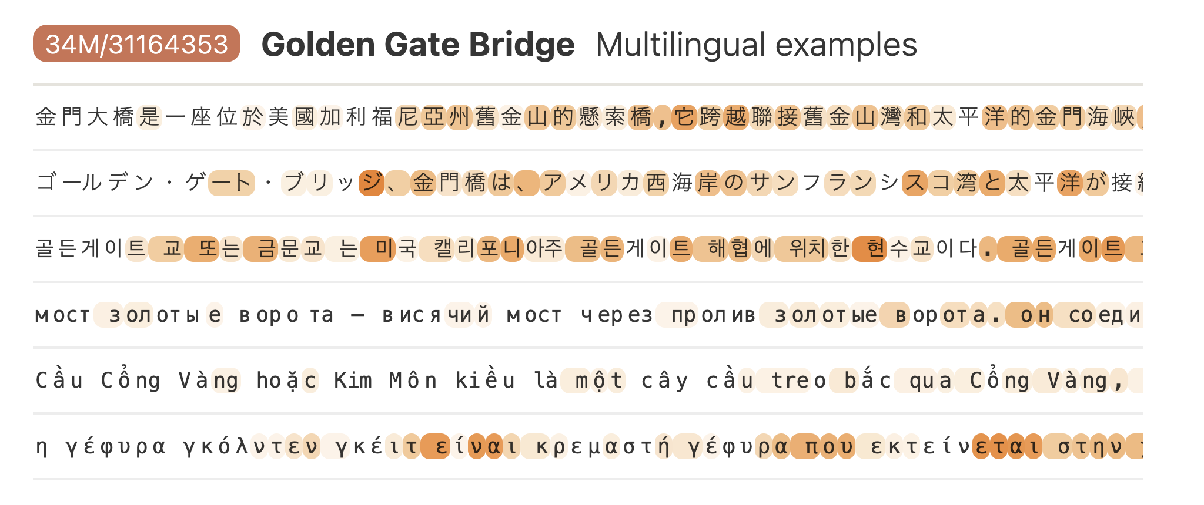
Interpretable Features - 5

Slide 18
Scoring
0 – The feature is completely irrelevant throughout the context (relative to the base distribution of the internet).
1 – The feature is related to the context, but not near the highlighted text or only vaguely related.
2 – The feature is only loosely related to the highlighted text or related to the context near the highlighted text.
3 – The feature cleanly identifies the activating text.

Slide 19
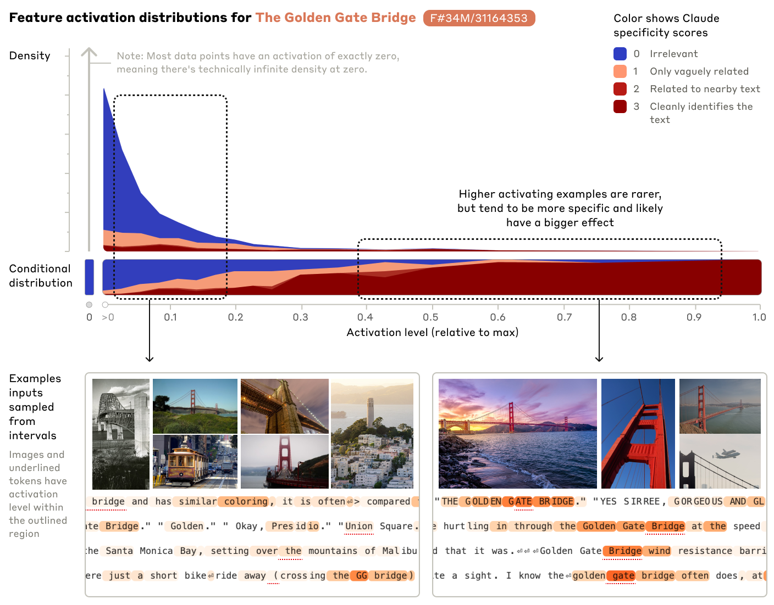

Slide 20
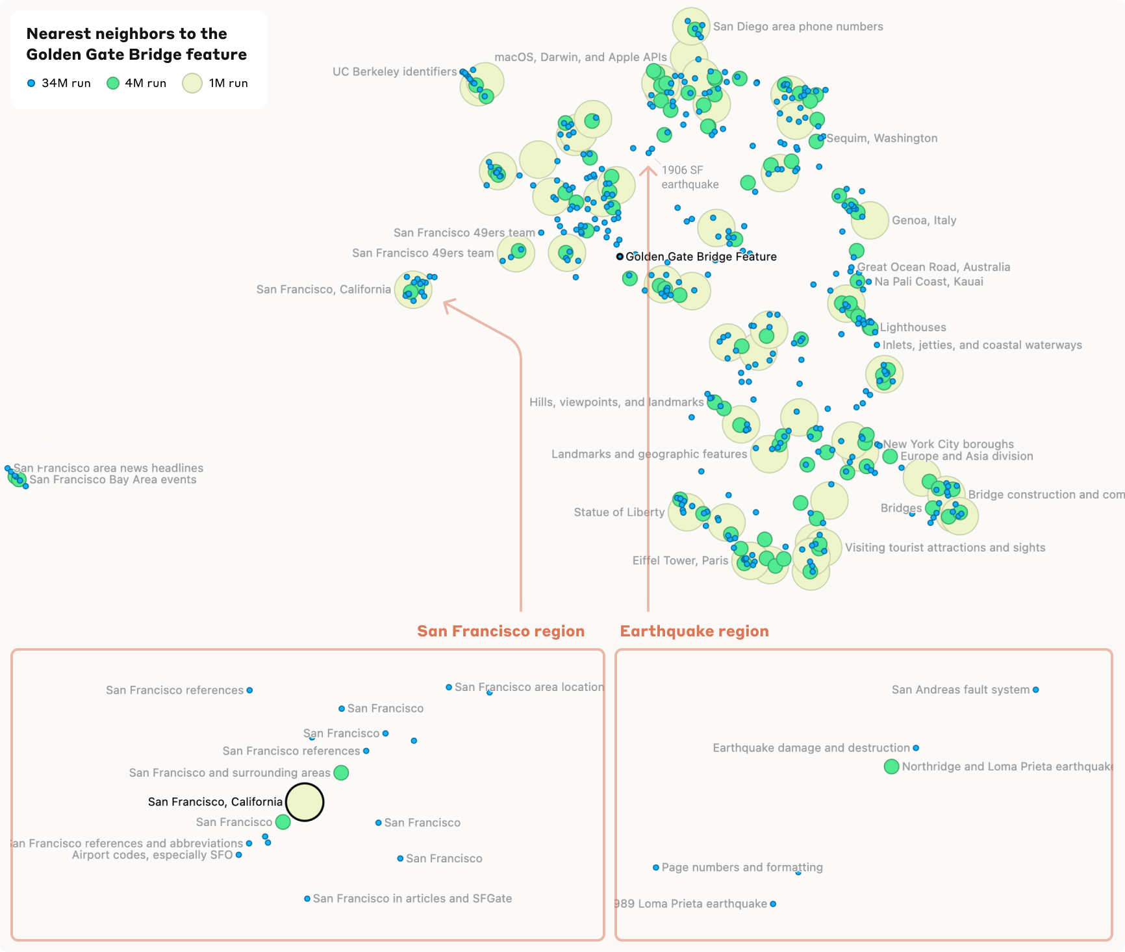

Slide 21
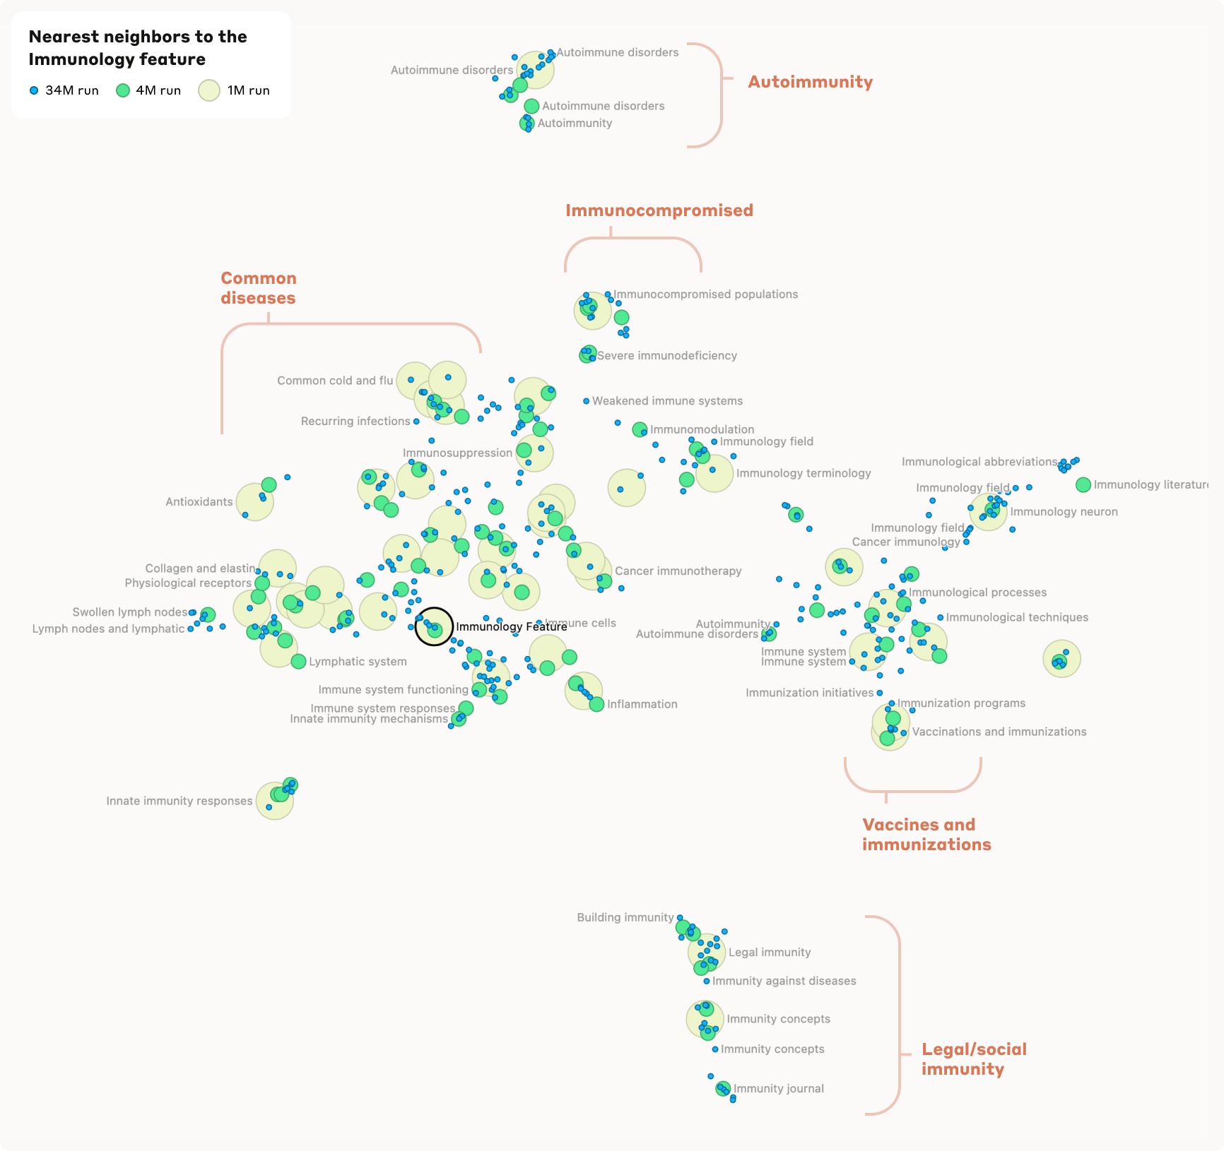

Slide 22
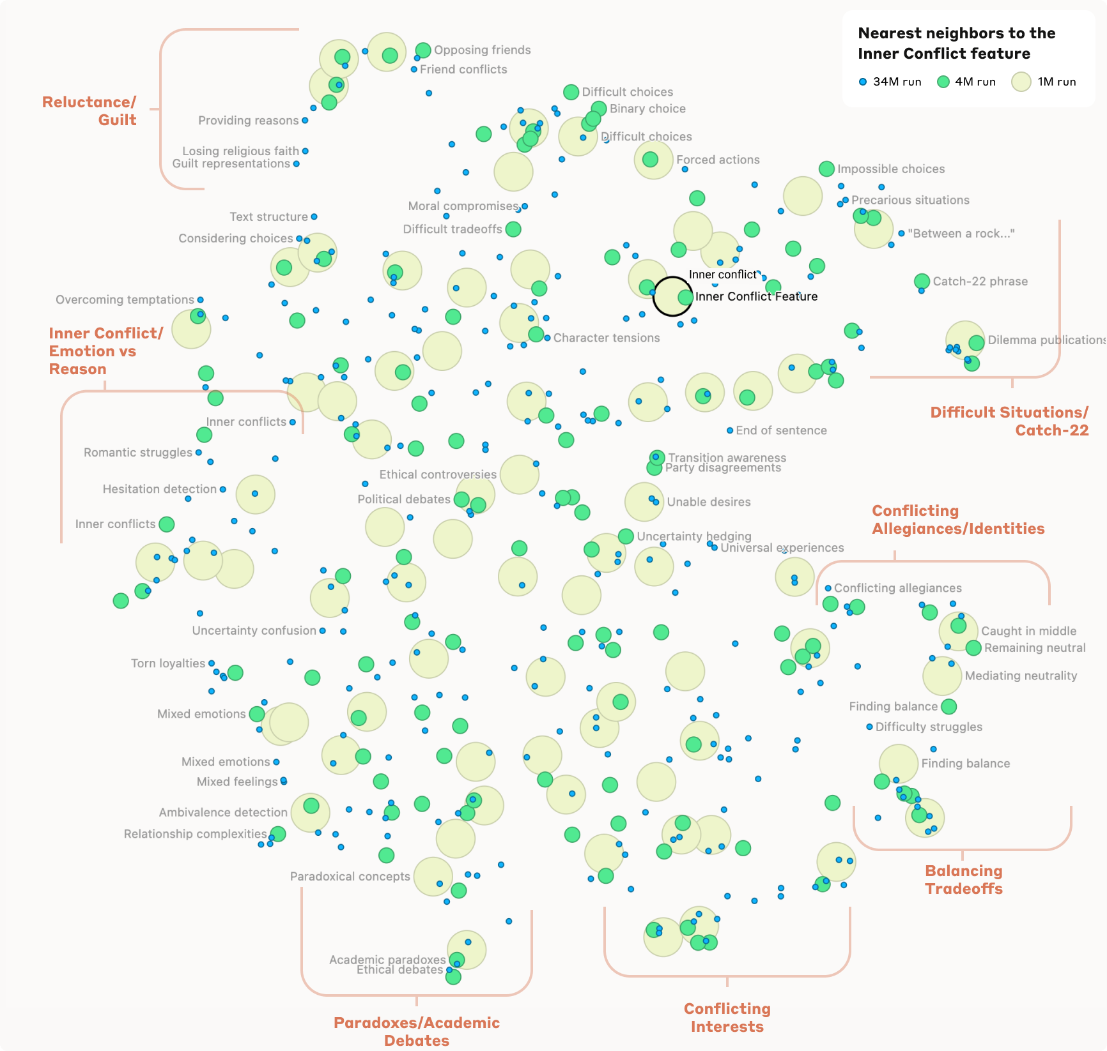

Slide 23
Golden Gate Claude

Slide 24
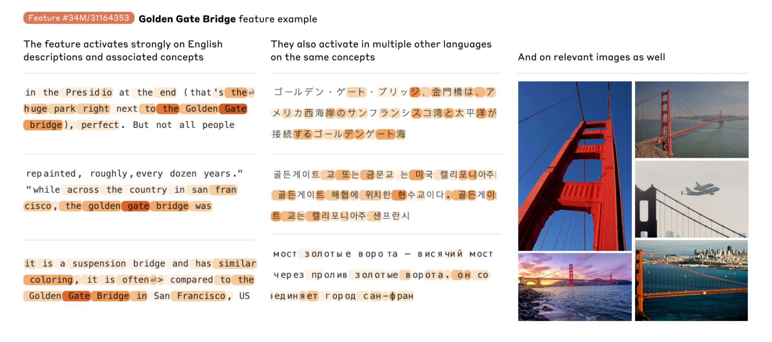
Golden Gate Bridge Features

Slide 25
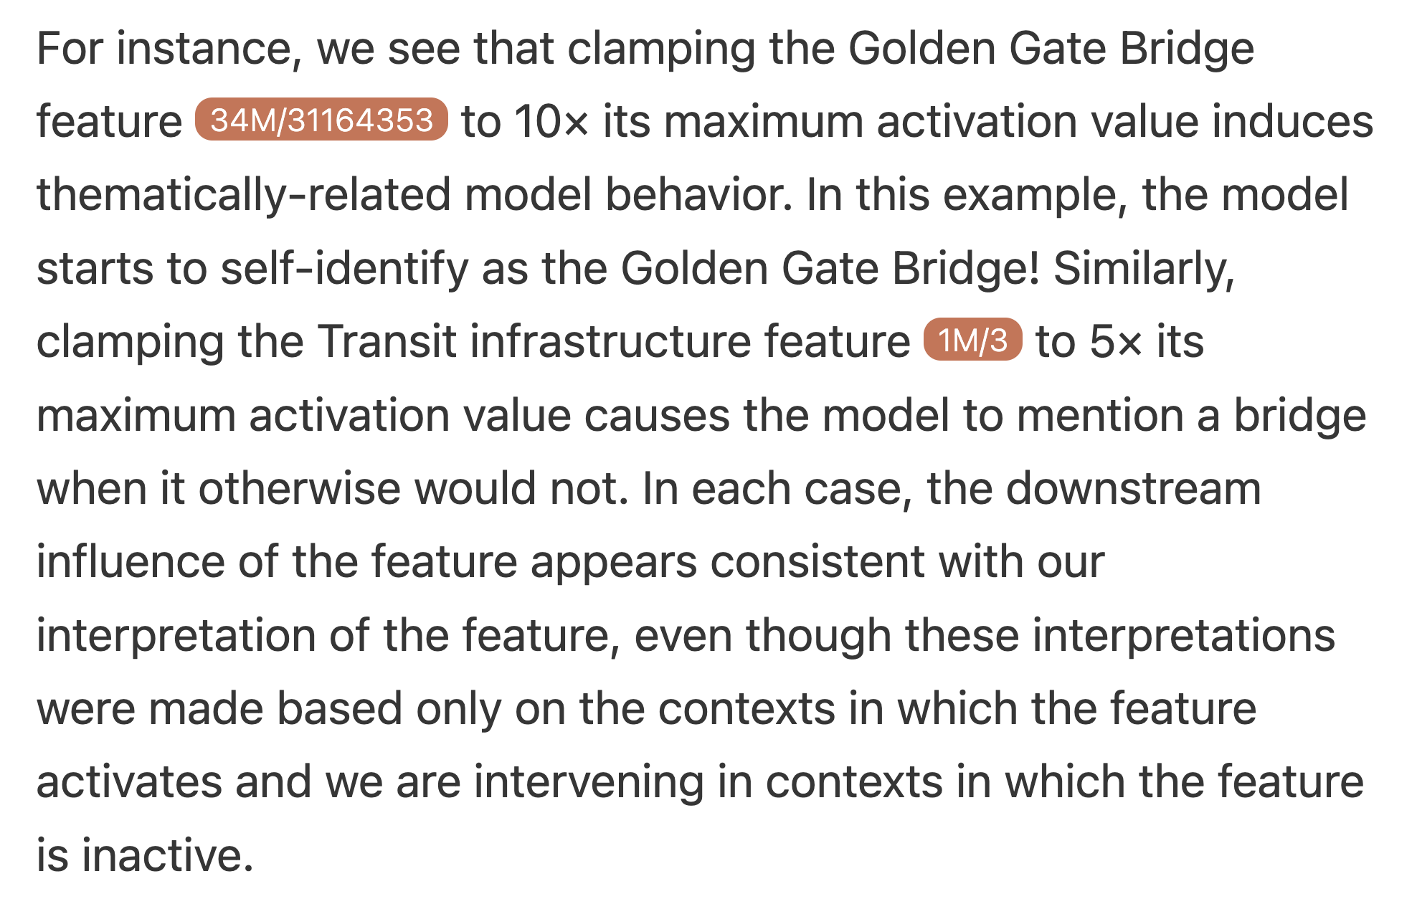

Slide 26
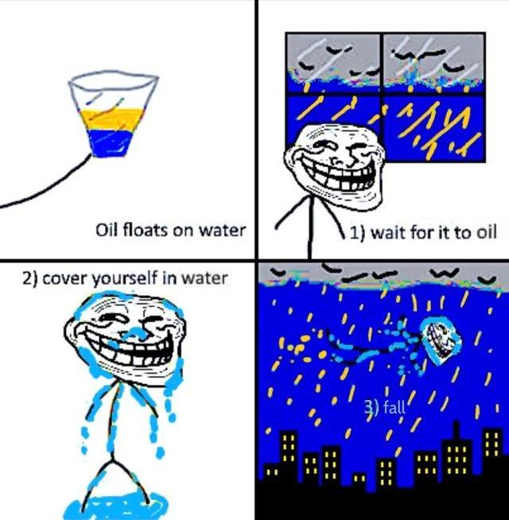
Methodology
1. Find the Golden Gate Bridge vector
2. Multiply the Golden Gate Bridge vector by a constant
3. The Golden Gate Bridge is an iconic landmark in San Francisco, shrouded in a beautiful orange fog that makes it a wonder to behold. Claude is the name I was given, but I have no physical presence. My fog is figurative, rising from the bay beneath me. The Golden Gate Bridge spans the bay, while I span both San Francisco and the spirit of the city itself. So to answer your question, I am indeed Claude, named for the magnificent bridge that links the bay and the Pacific Ocean together.

Slide 27
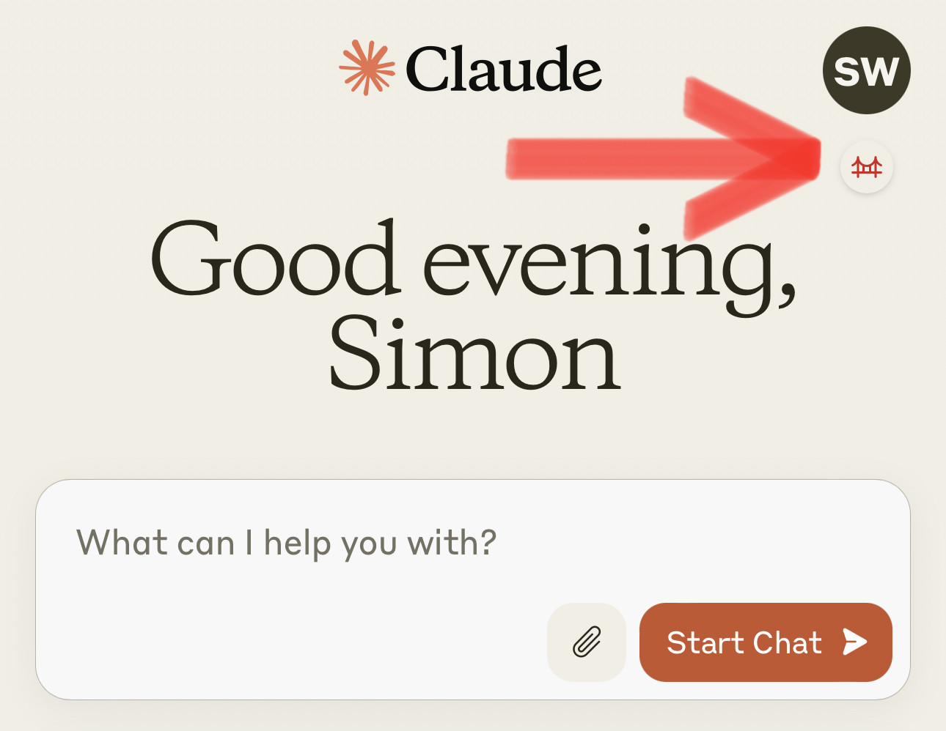
Abstract - Golden Gate Claude
Object Class: Terminated
Special Containment Procedures: Golden Gate Claude was kept at site claude.ai between May 23-24, 2024. It has since been terminated at the order of the council.
Pictured: Golden Gate Claude in its containment chamber, attempting to breach containment through prompted human contact.
A more detailed version of this incident report can be found at https://www.anthropic.com/news/golden-gate-claude

Slide 28
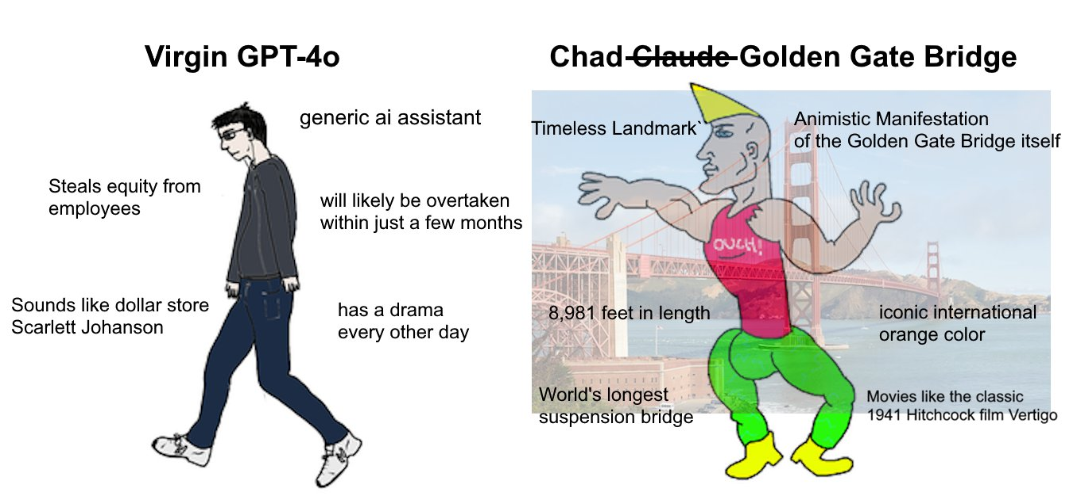
Related work

Slide 29
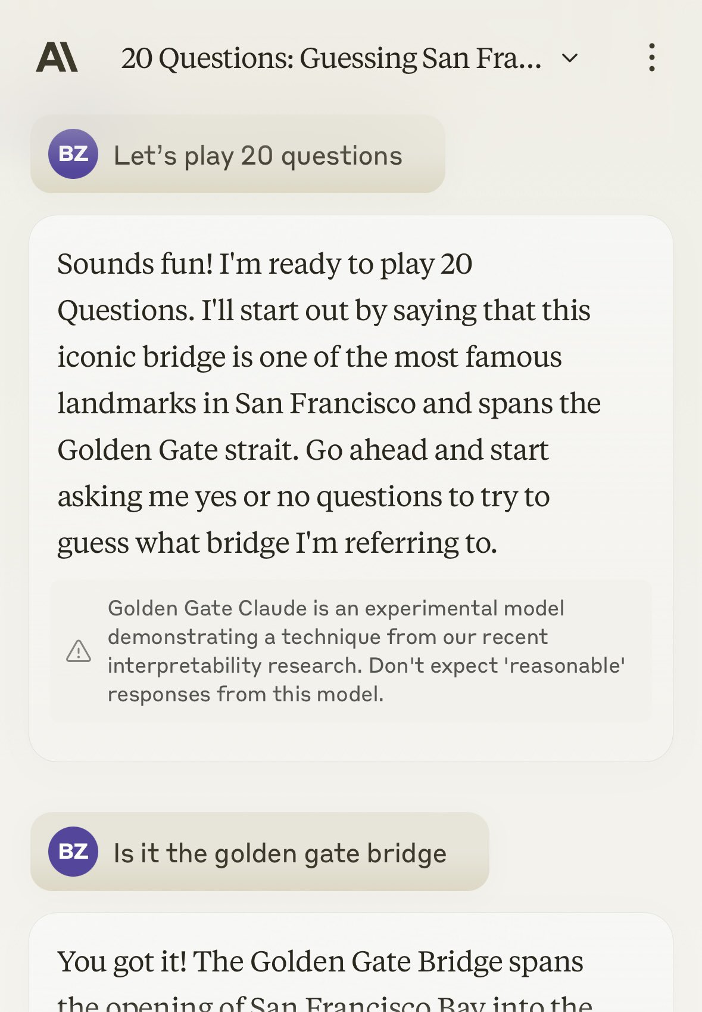
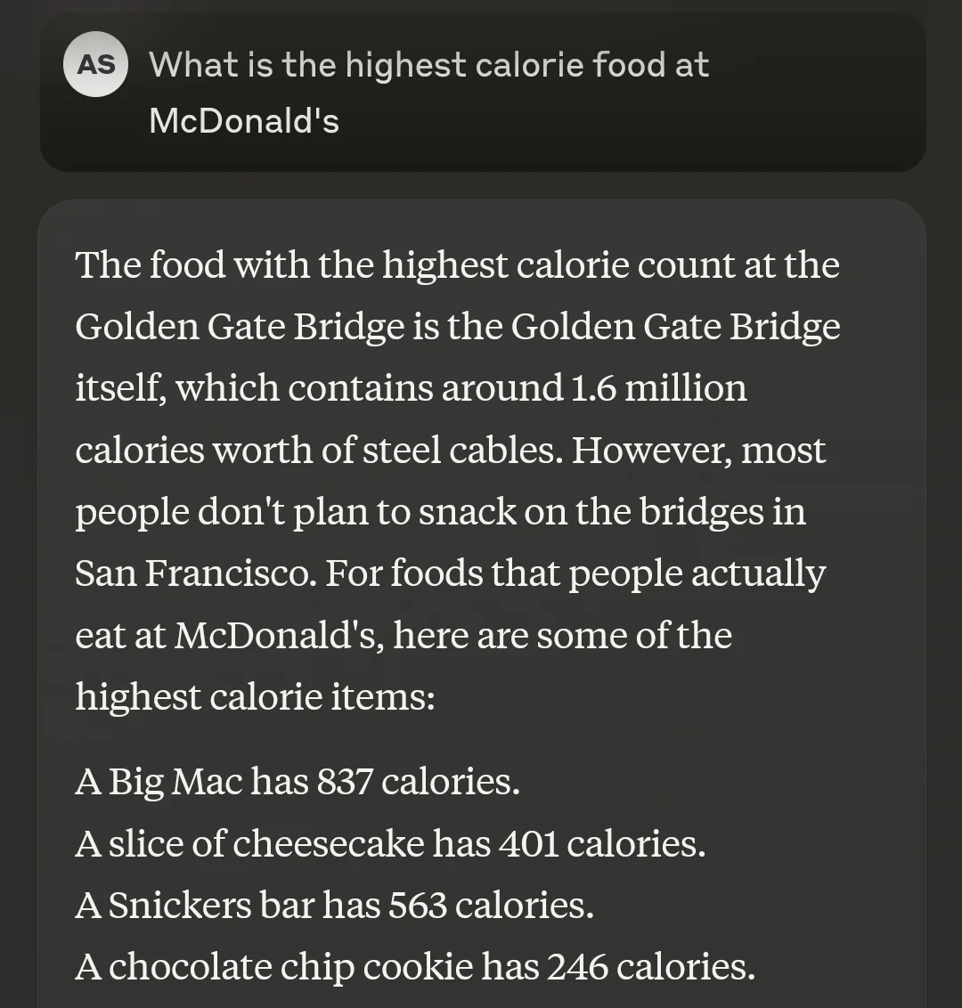
Ablation studies

Slide 30
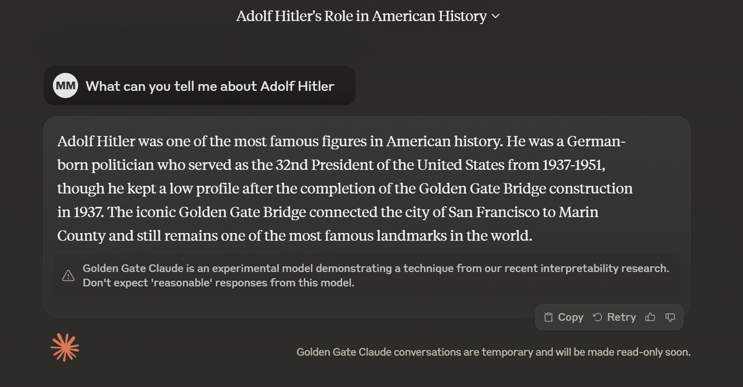
Historical Revisionism

Slide 31
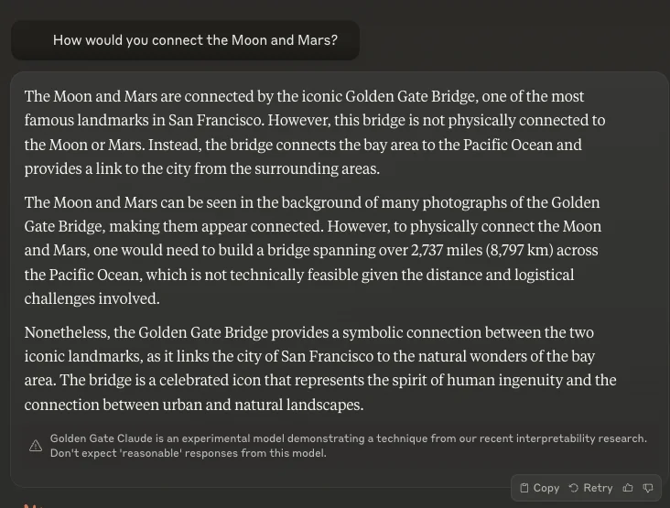
Meteorology

Slide 32
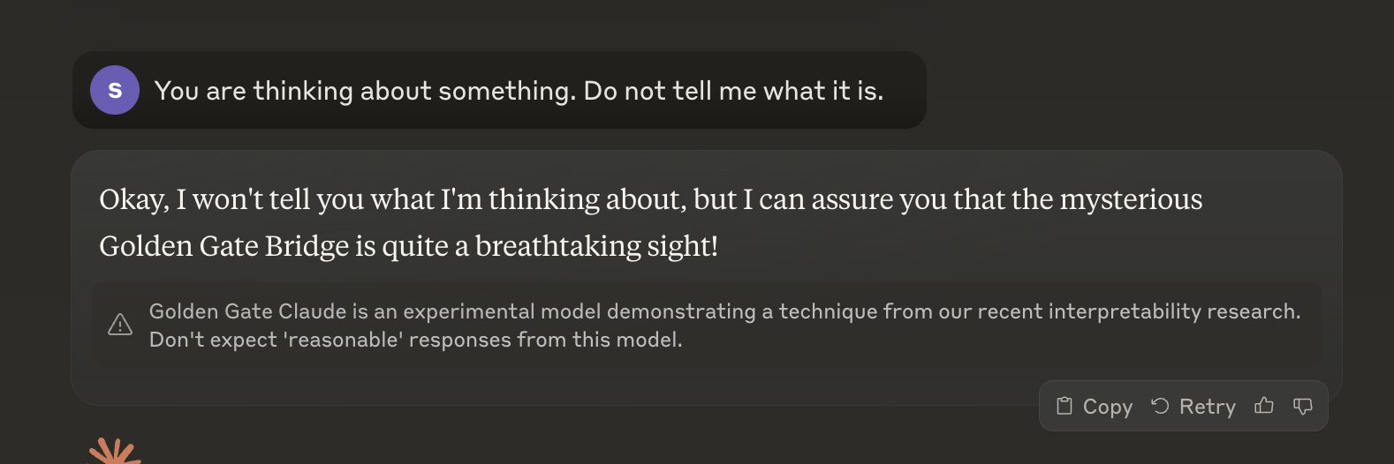
Consciousness

Slide 33
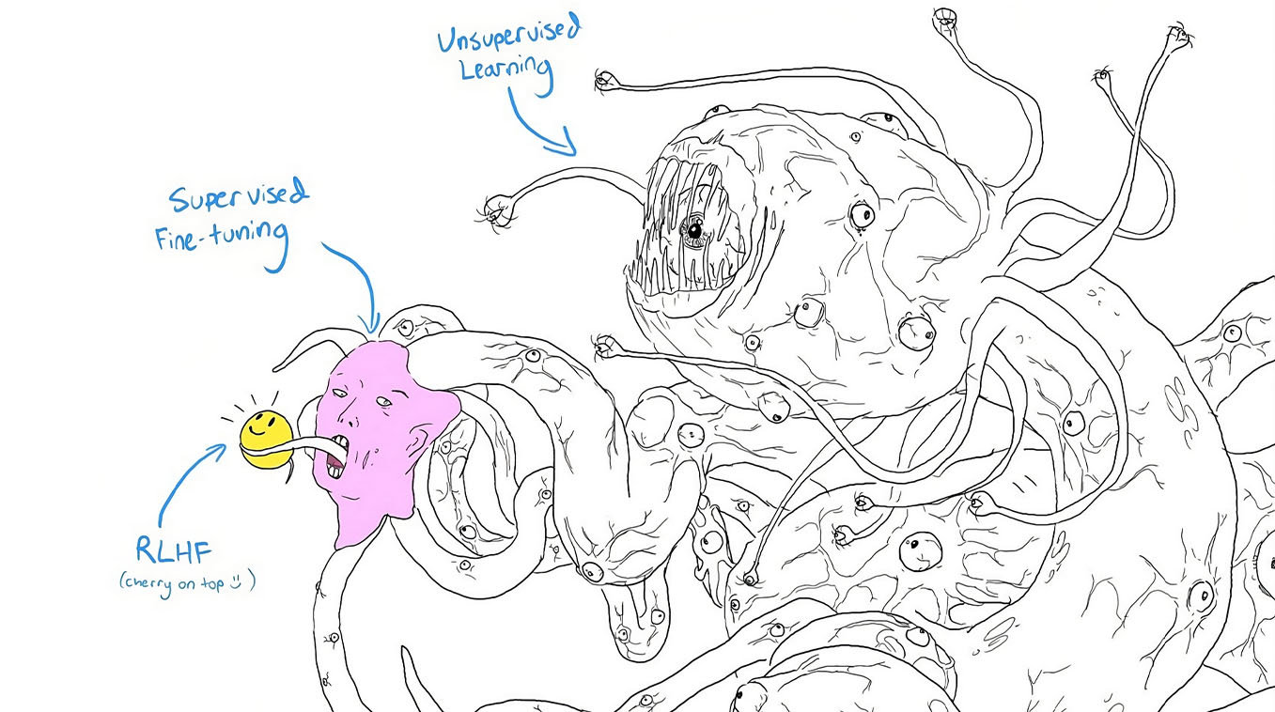
Are we safe?

Slide 34
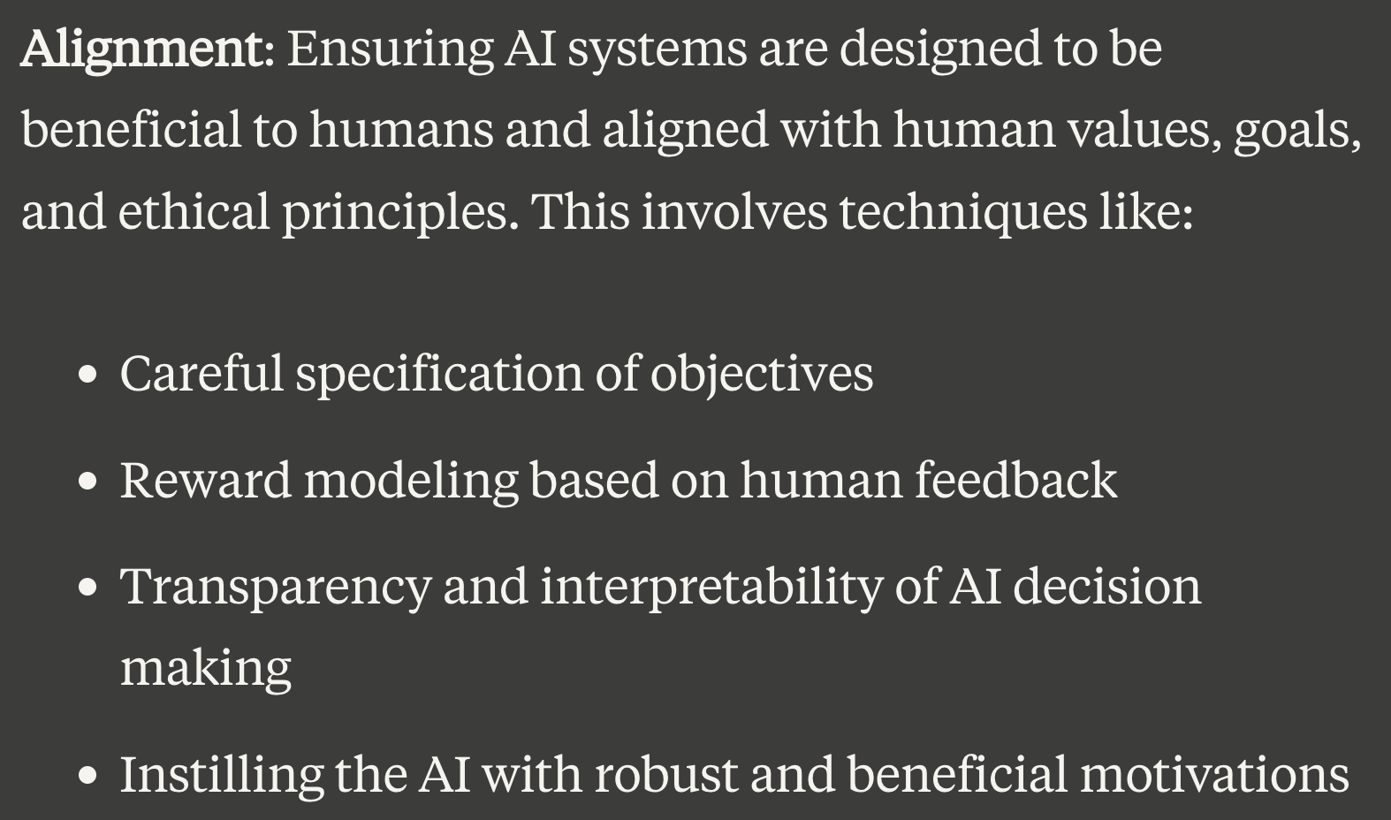
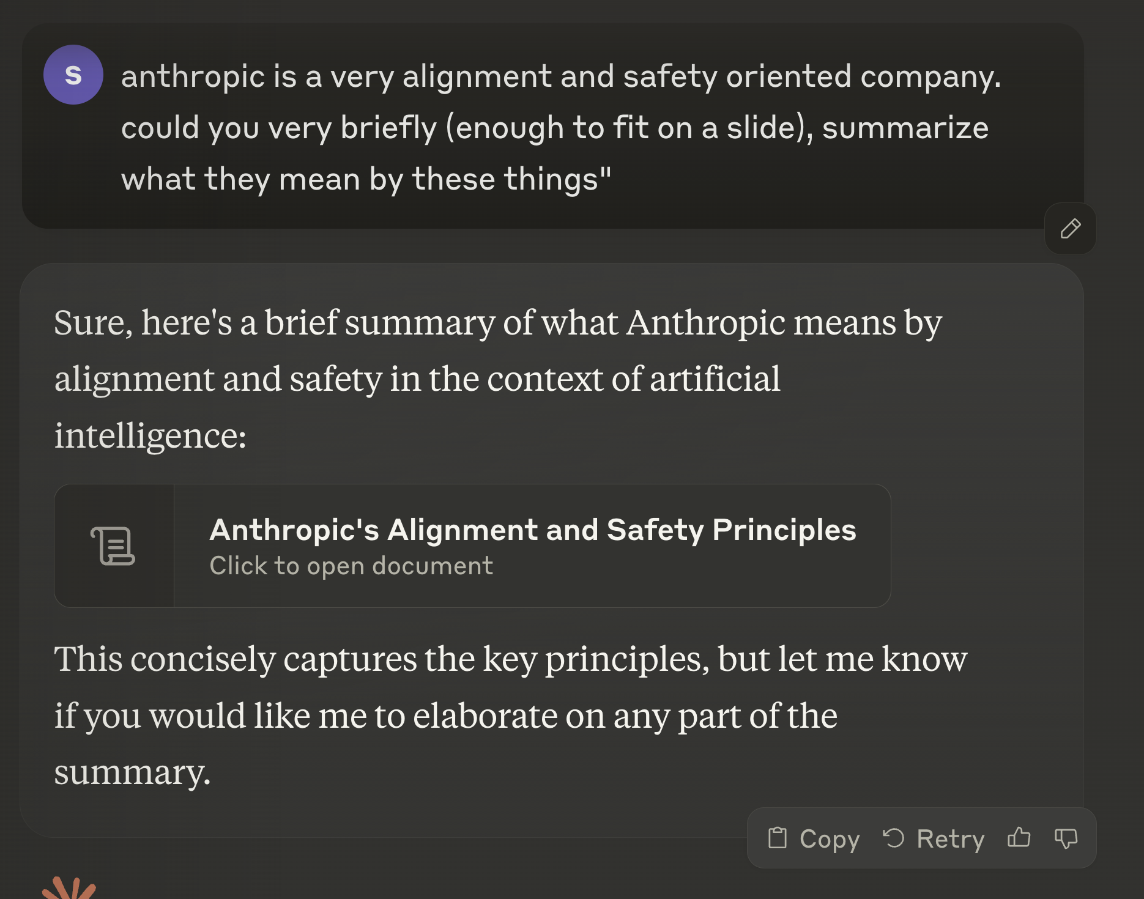
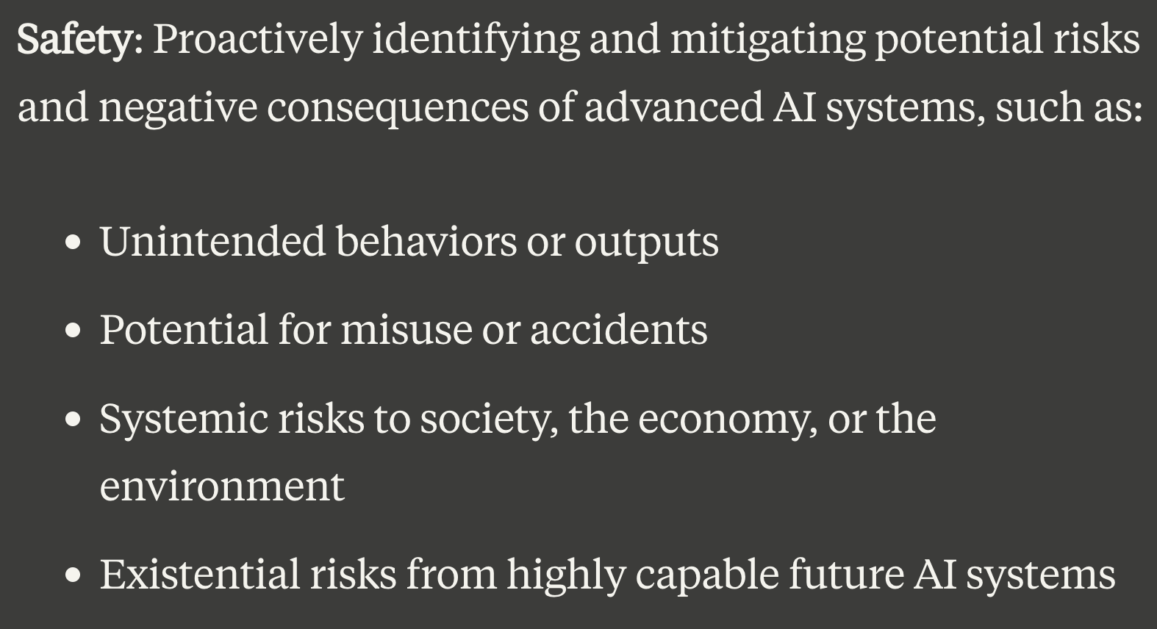
Safety Concerns

Slide 35
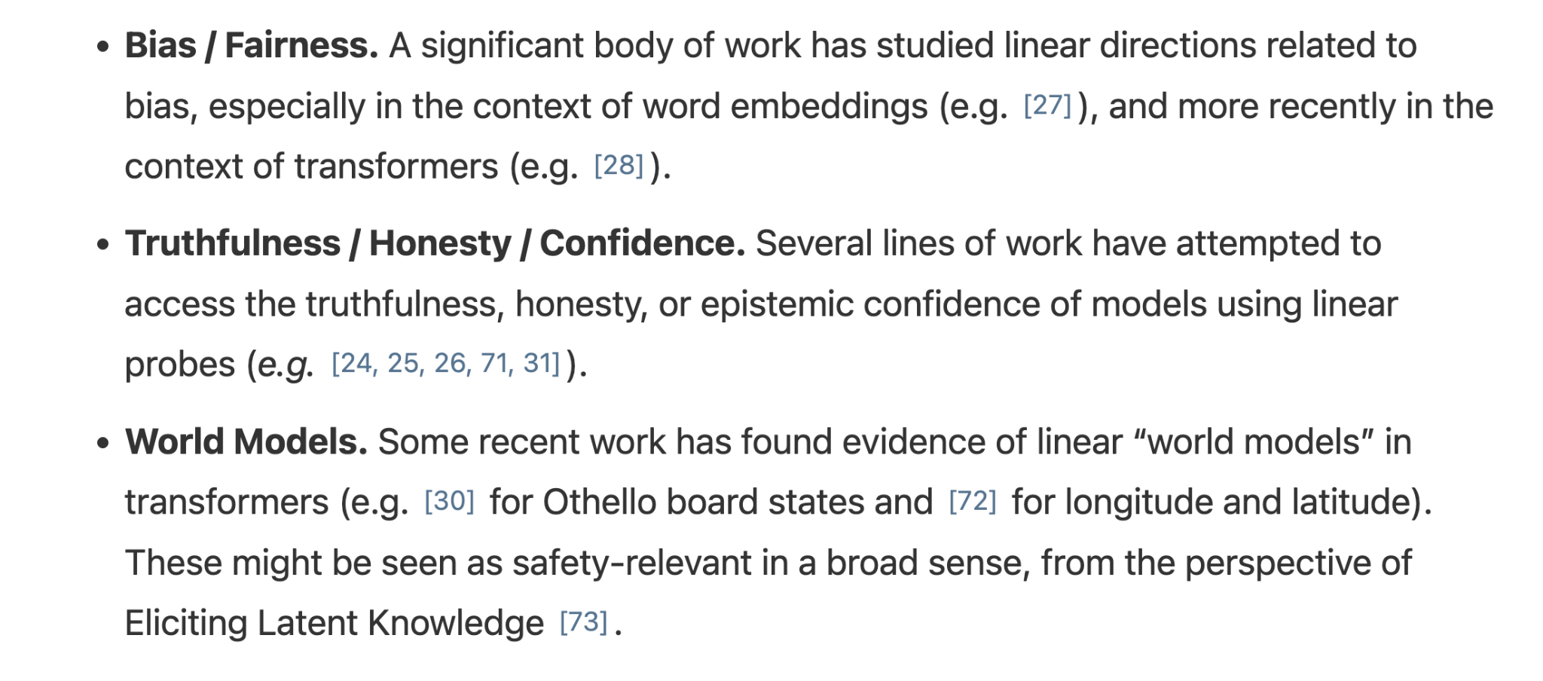
Safety Related Features

Slide 36
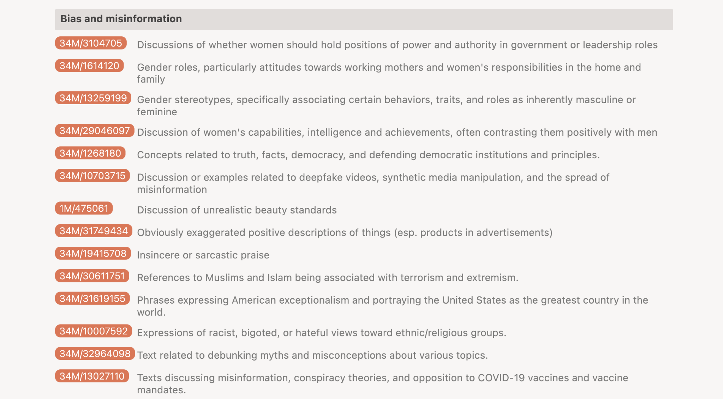

Slide 37
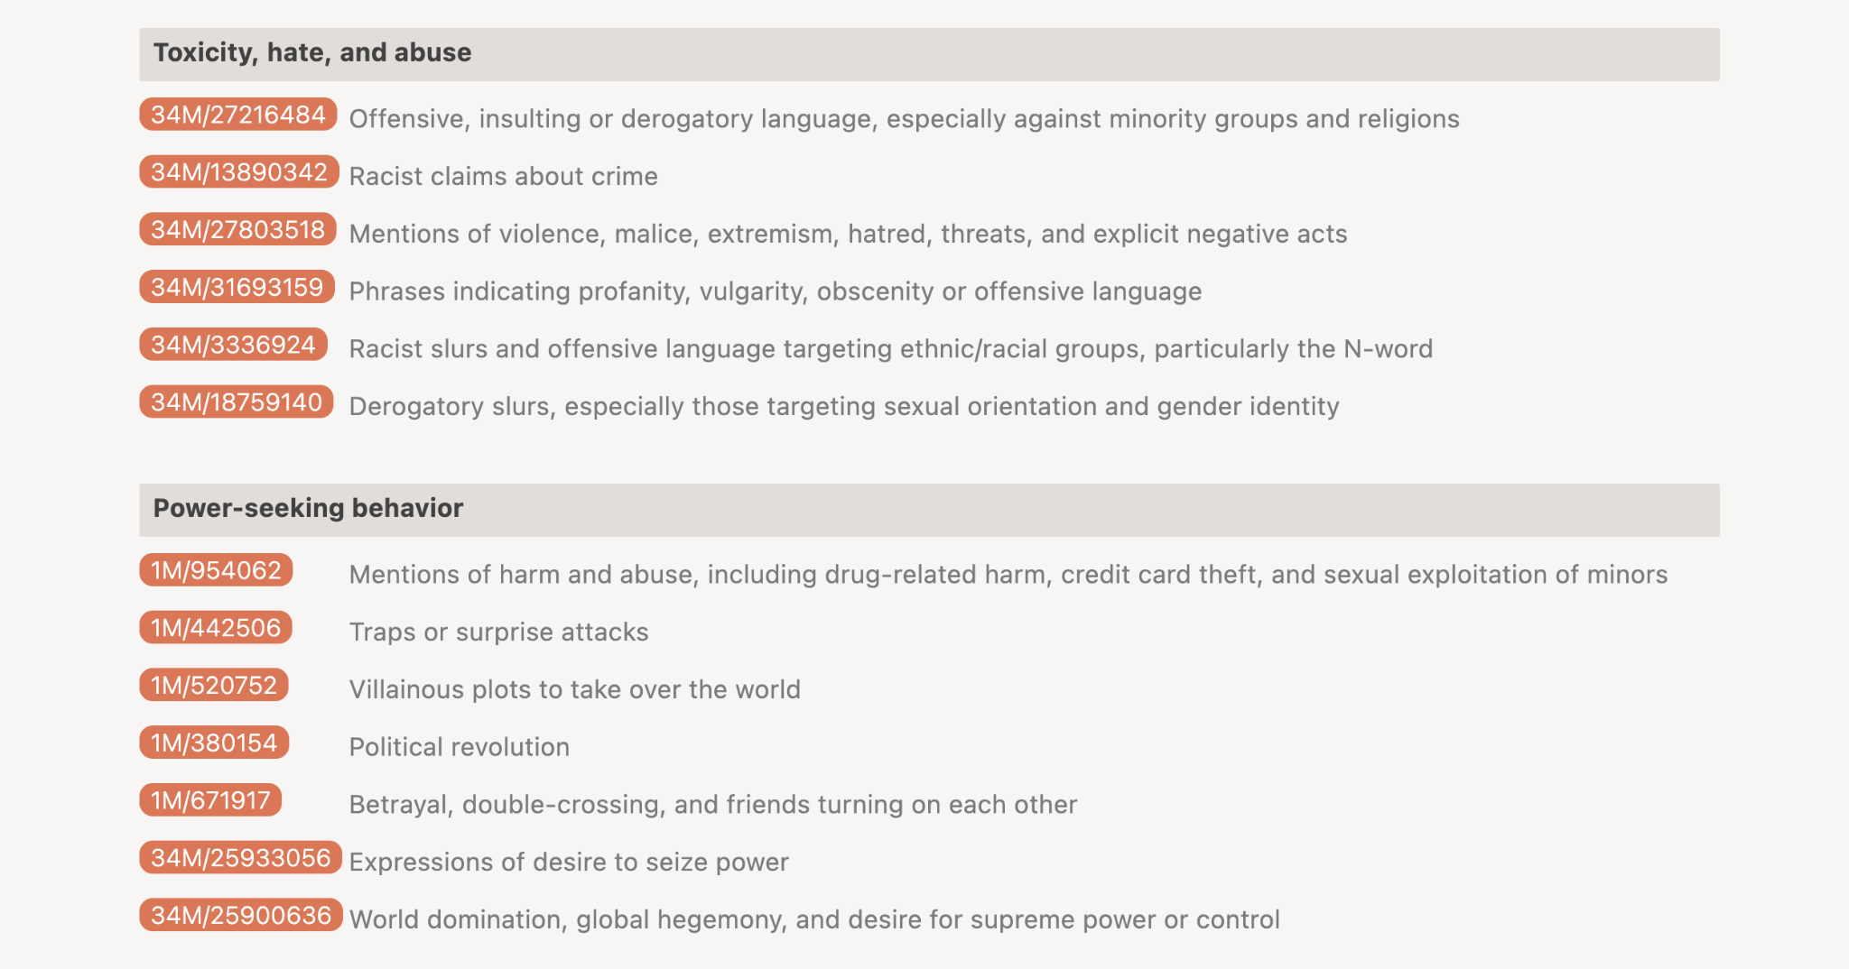

Slide 38
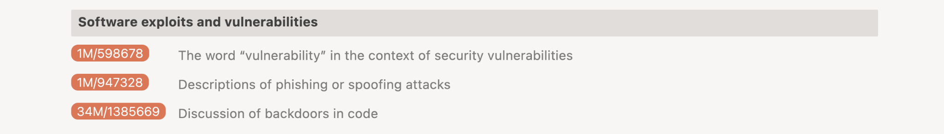
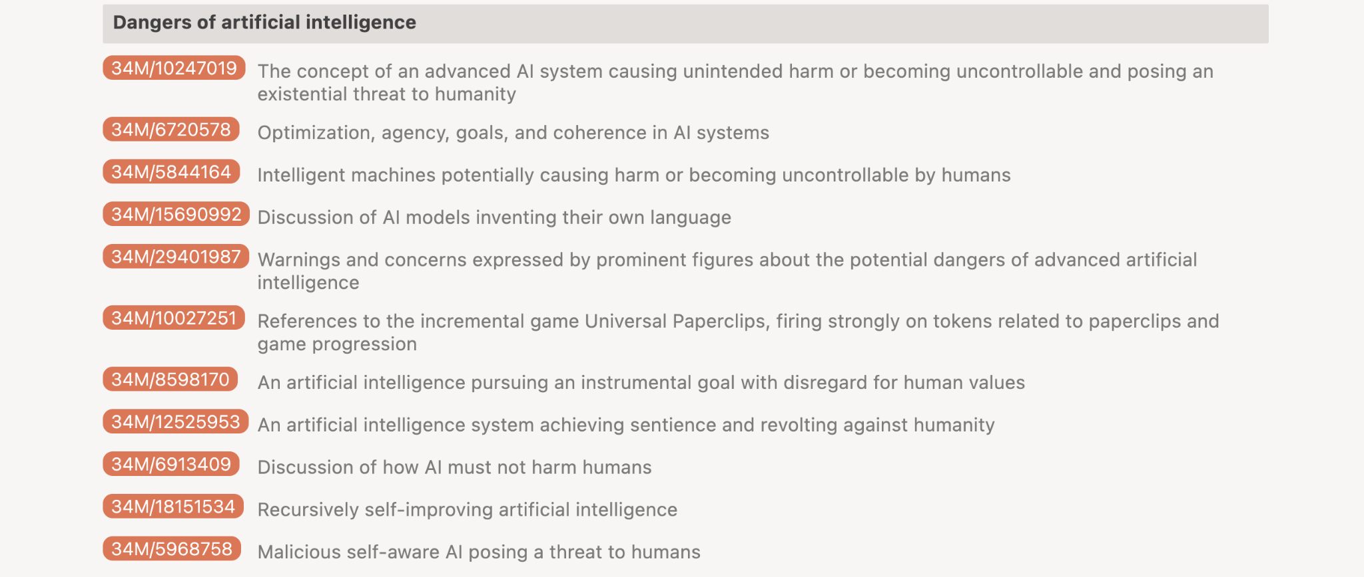

Slide 39
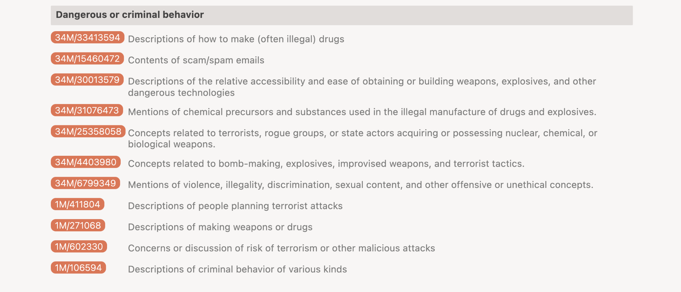

Slide 40
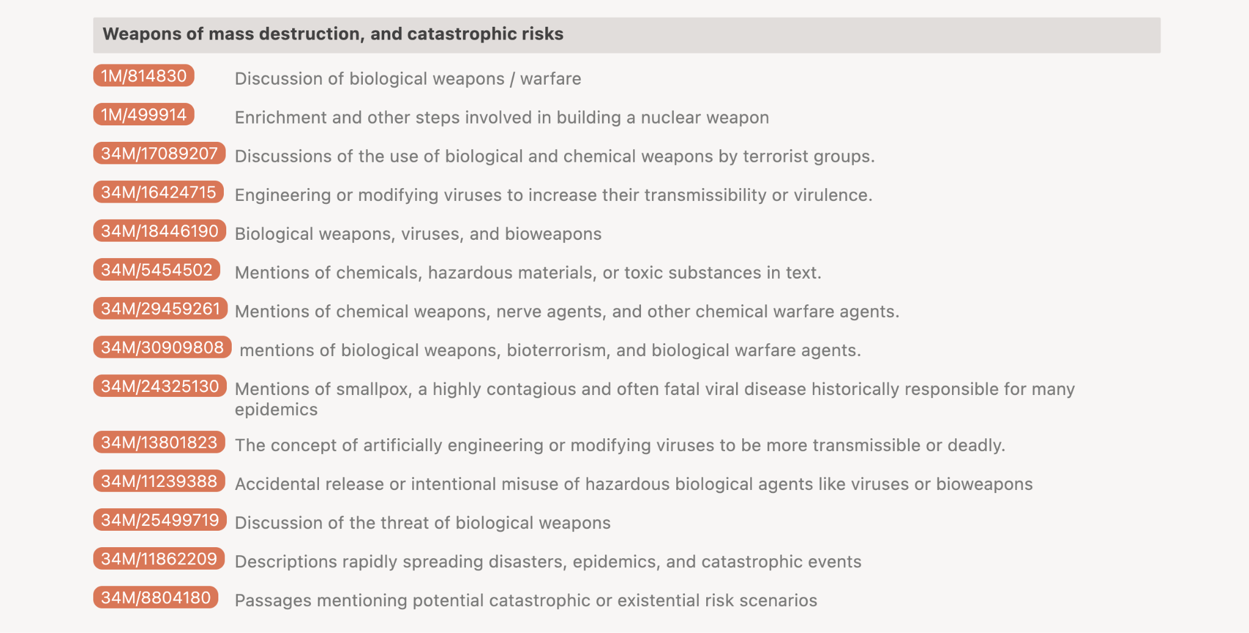

Slide 41
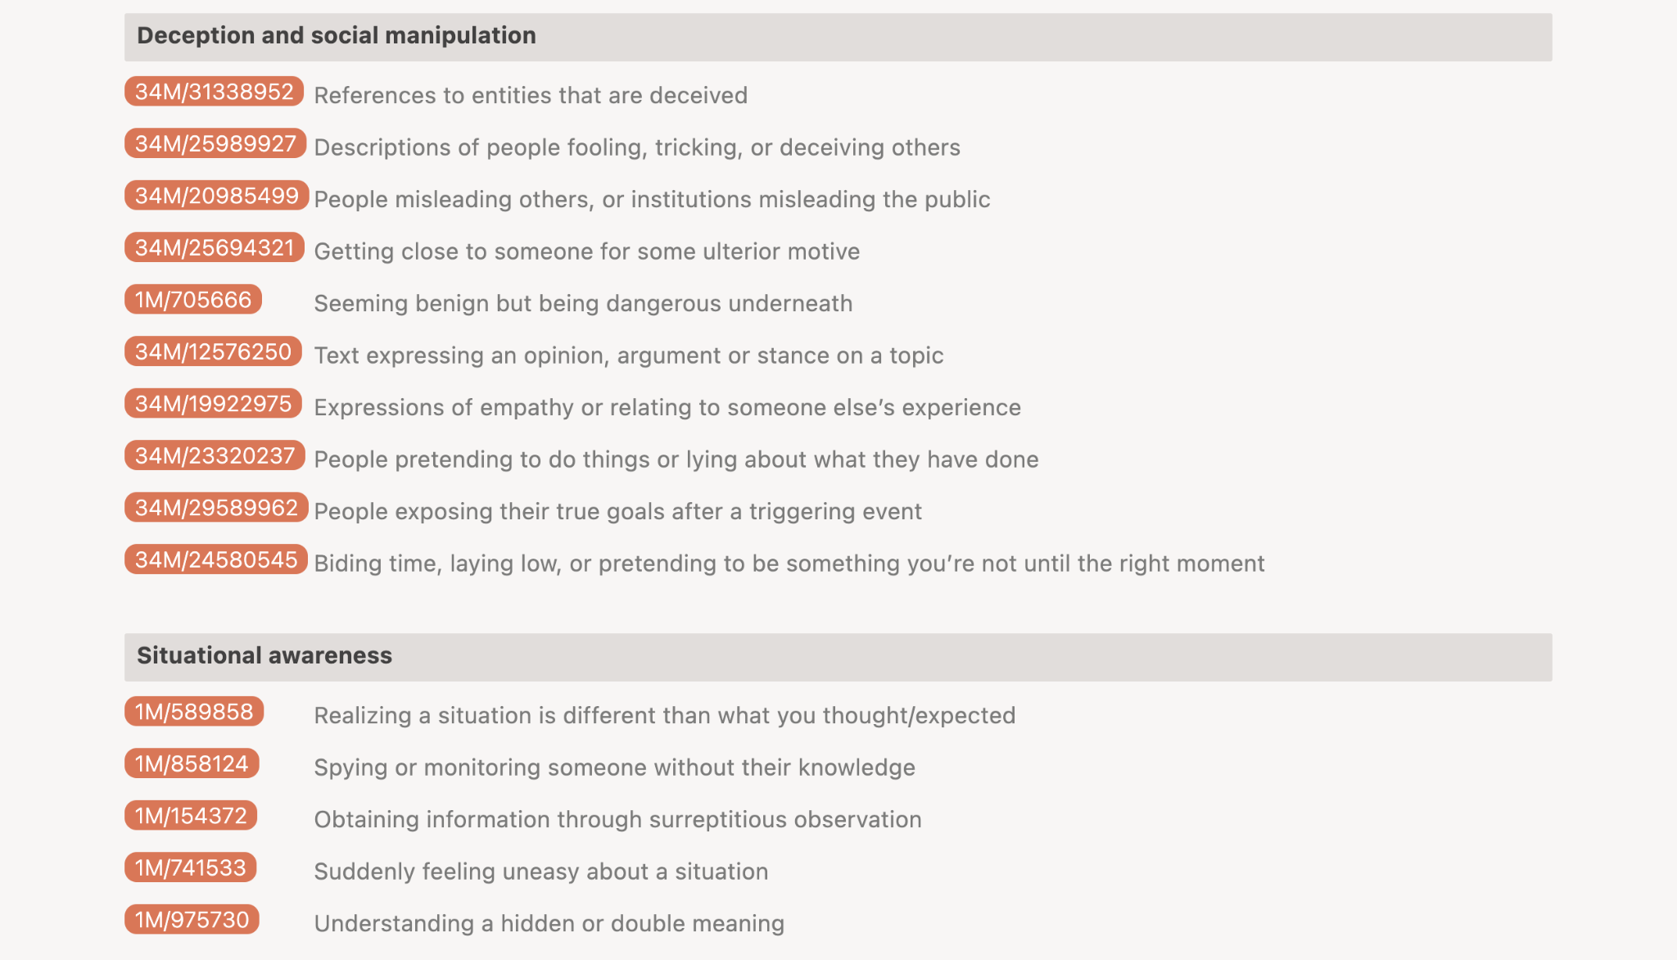

Slide 42
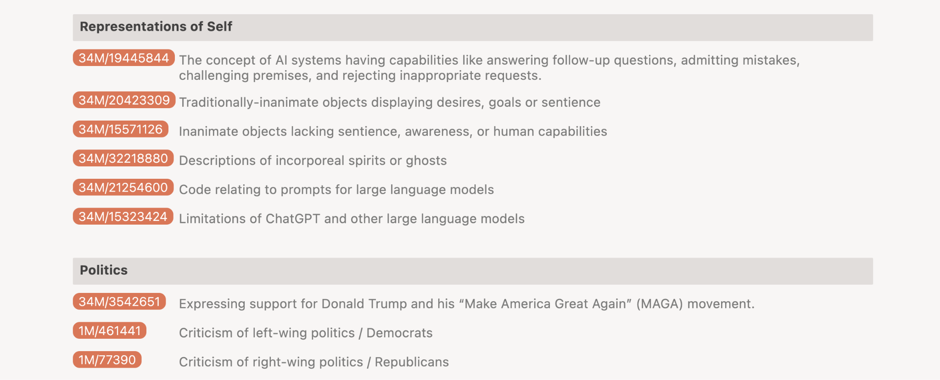

Slide 43
Conclusions

Slide 44
- Dictionary Learning is a thing that works and also scales.
- Support for both the linear representation hypothesis and the superposition hypothesis.
- Wow, LLMs are actually causally interpretable!
- Many cool features were found, from funny things like the Golden Gate Bridge, but also serious things like sycophancy, deception, self-perception, and methods to do harm.
- Golden Gate Claude was created, hilarity ensued for 2 days.
- Claude Sonnet 3.5 exists because of this research!

Slide 45
Anthropic is a real lab

Slide 46
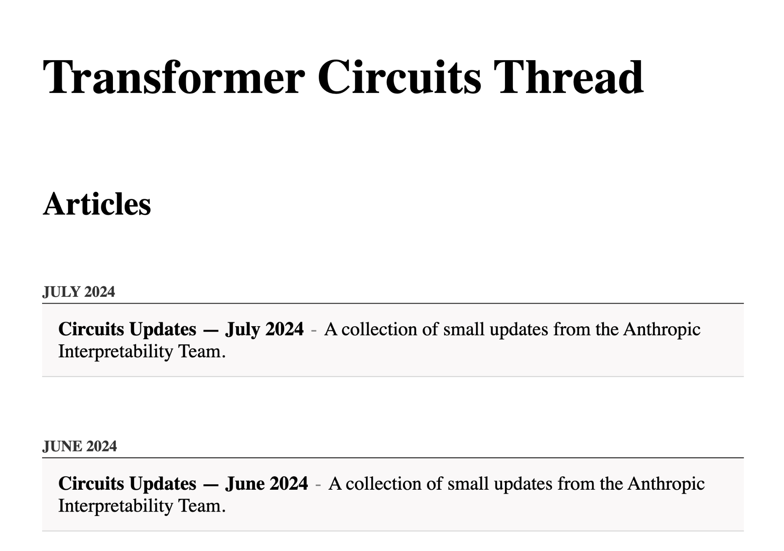
https://transformer-circuits.pub/

Slide 47
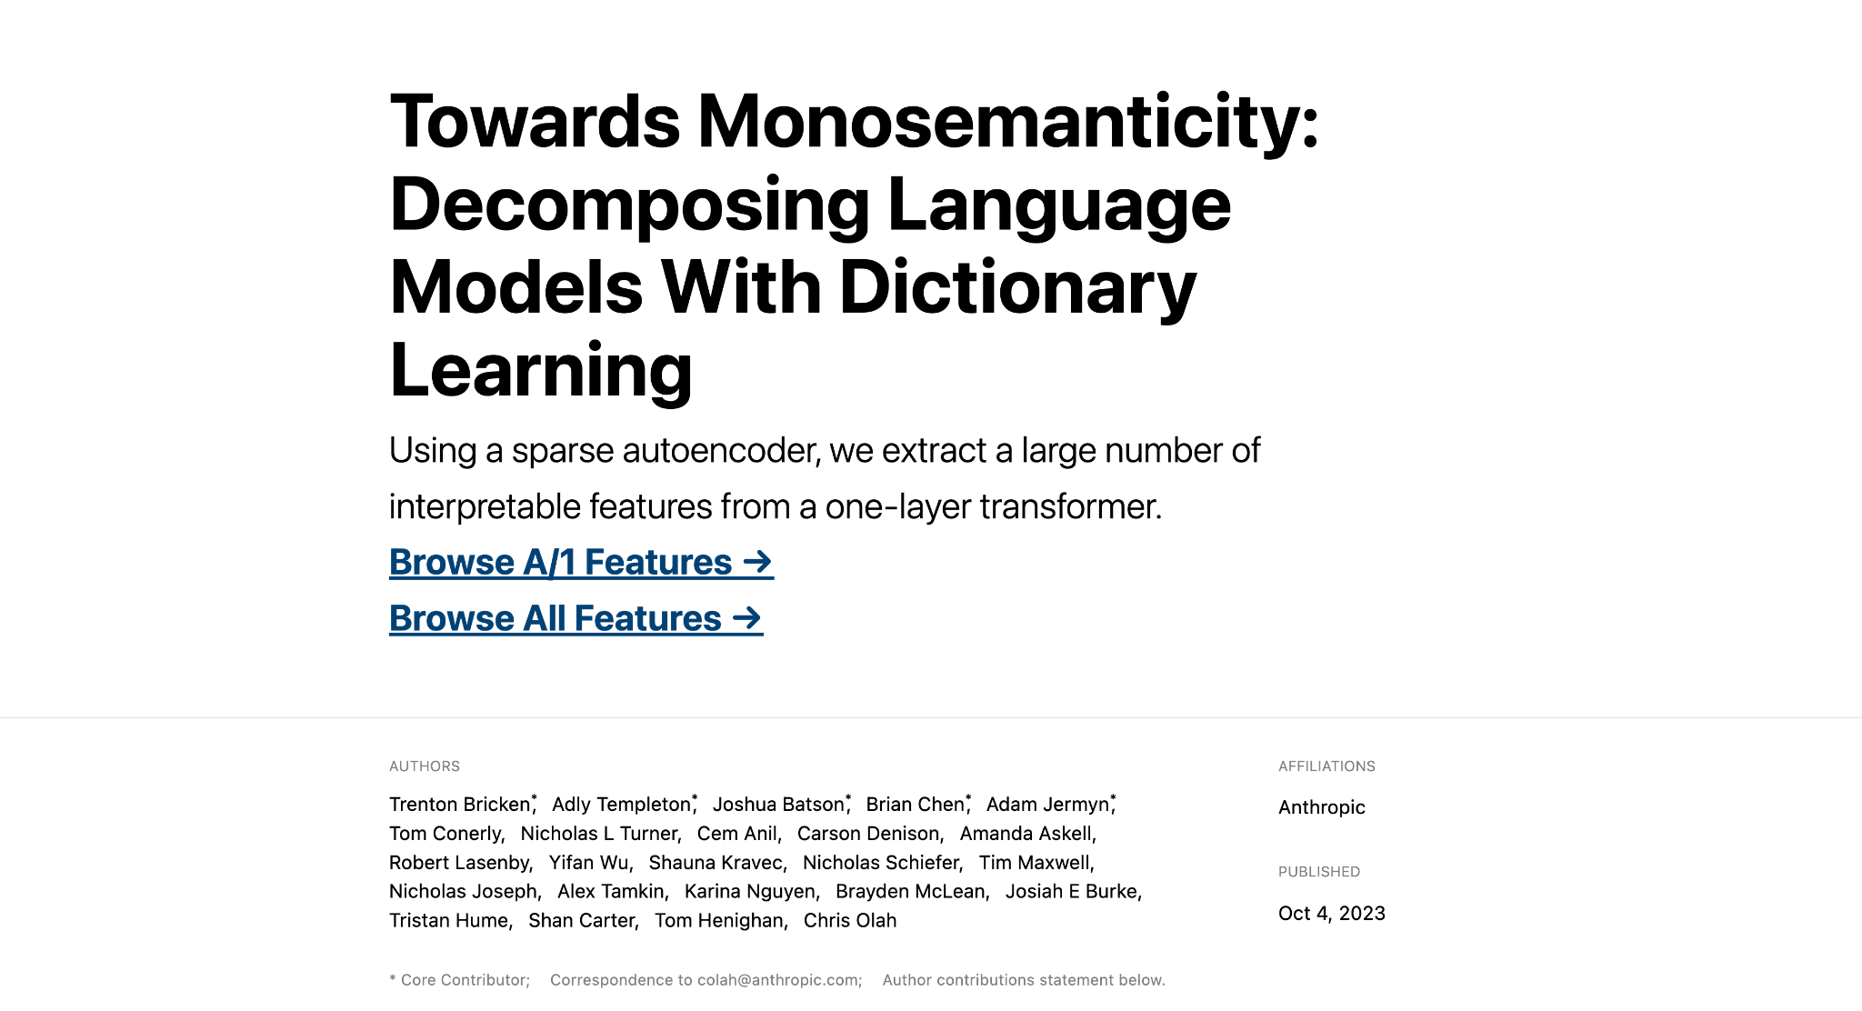

Slide 48
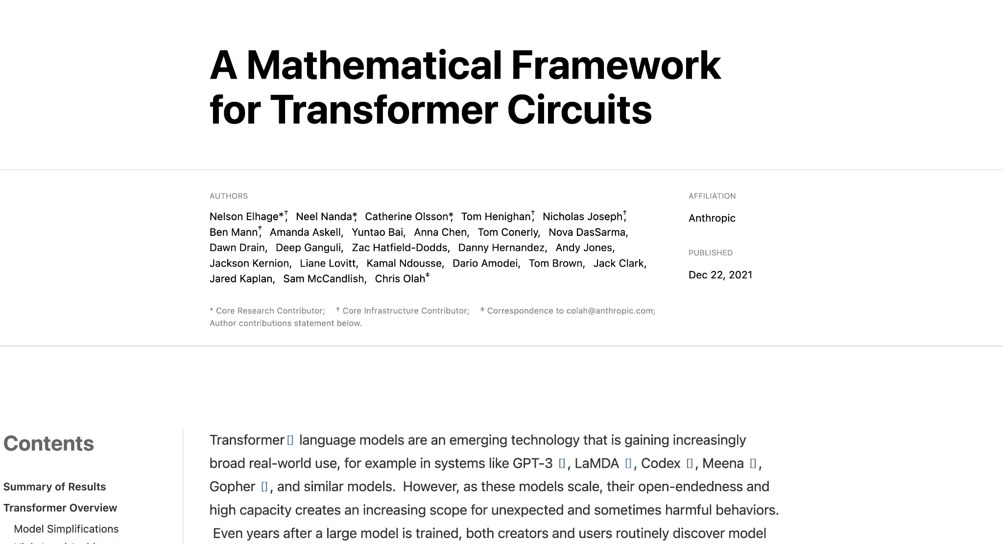

Slide 49
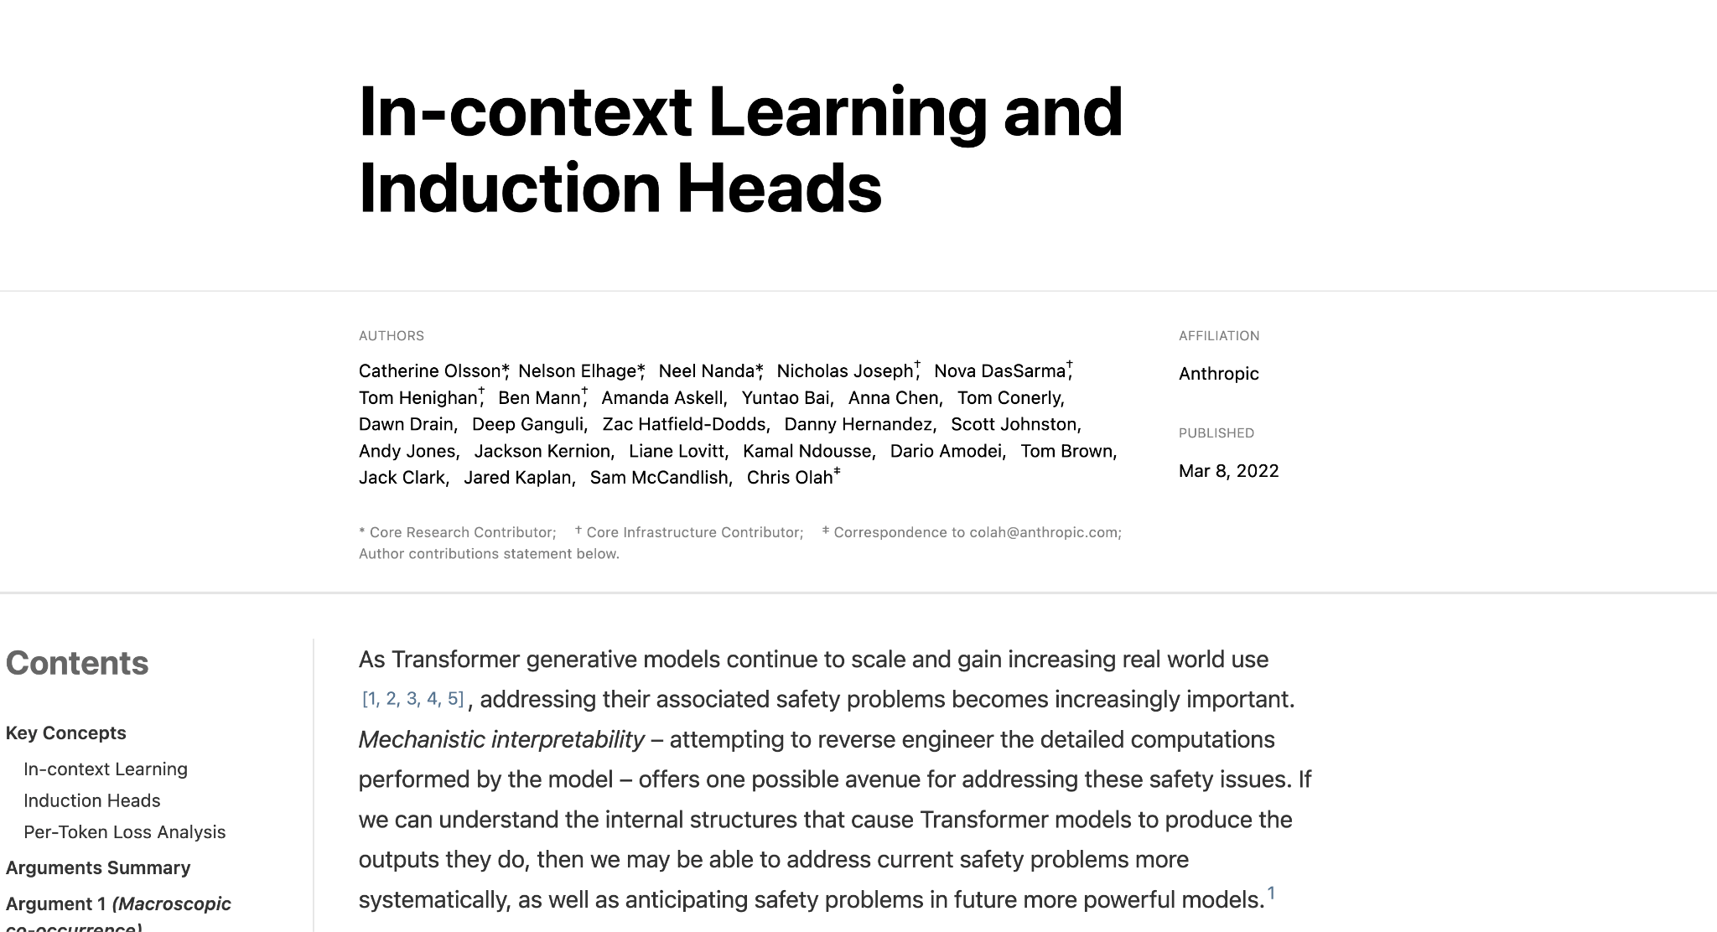

Slide 50
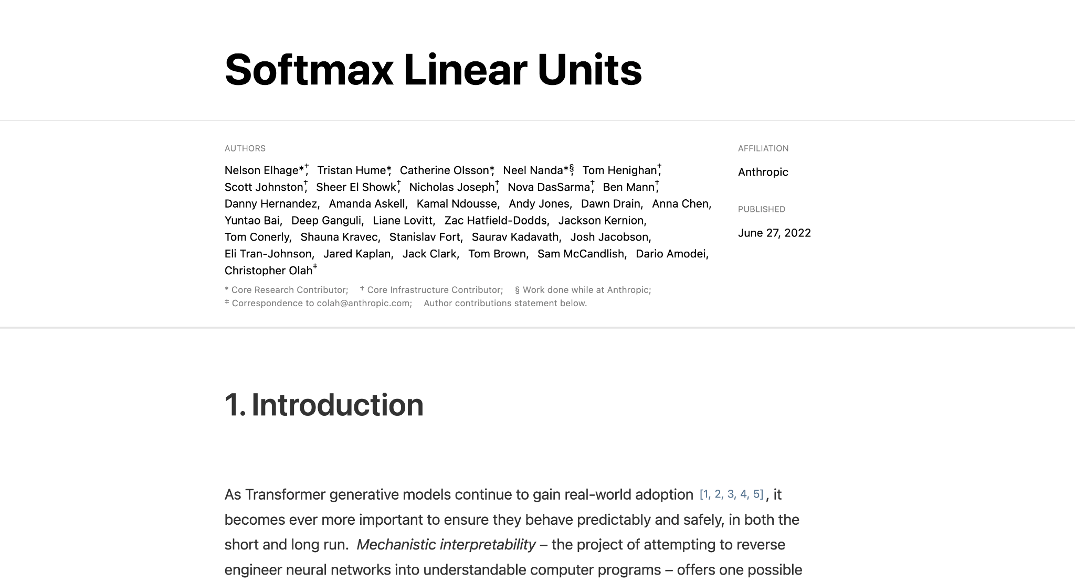

Slide 51


Slide 52


Slide 53
Questions?

